Slide 1
Deep Learning (CS 898-BD)
Fall 2023
Dr. Shruti Kshirsagar

Slide 2
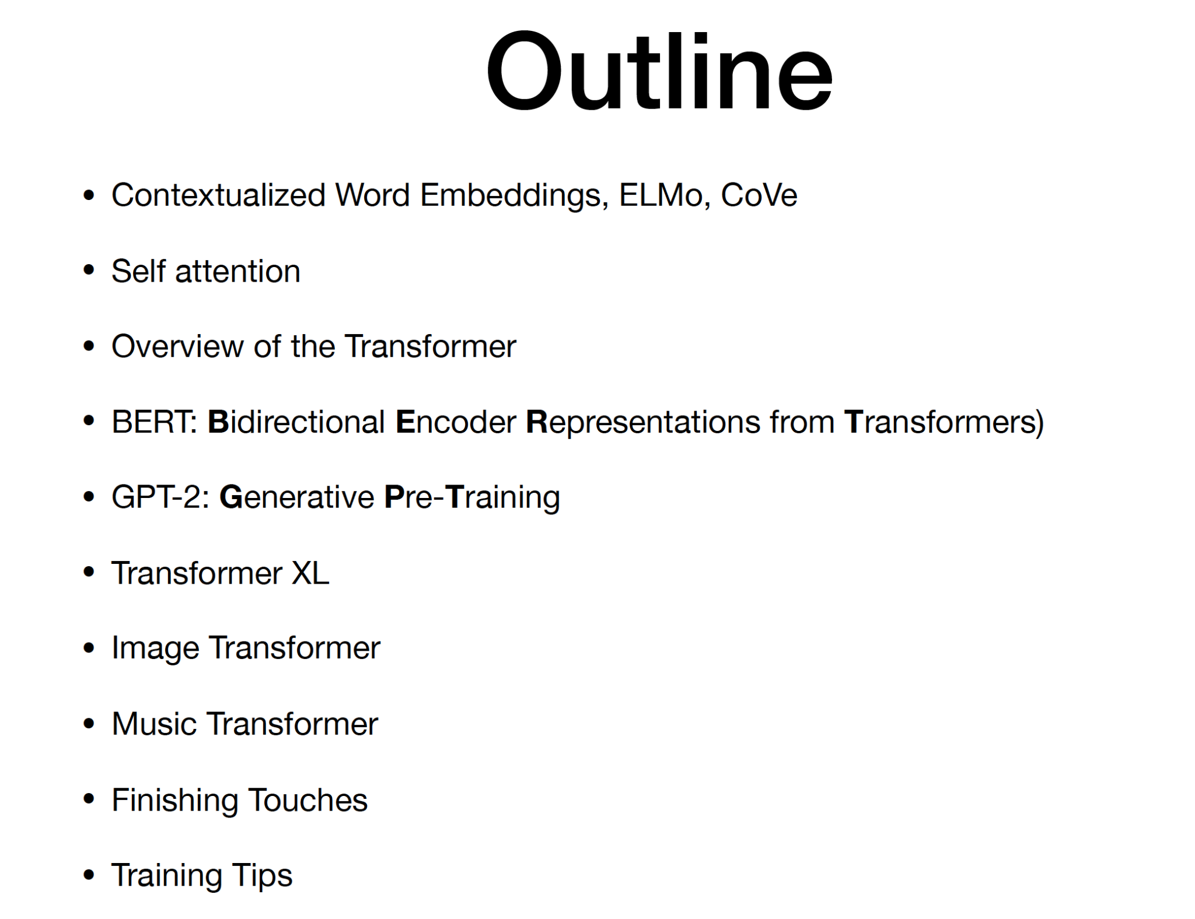
Contents:

Slide 3
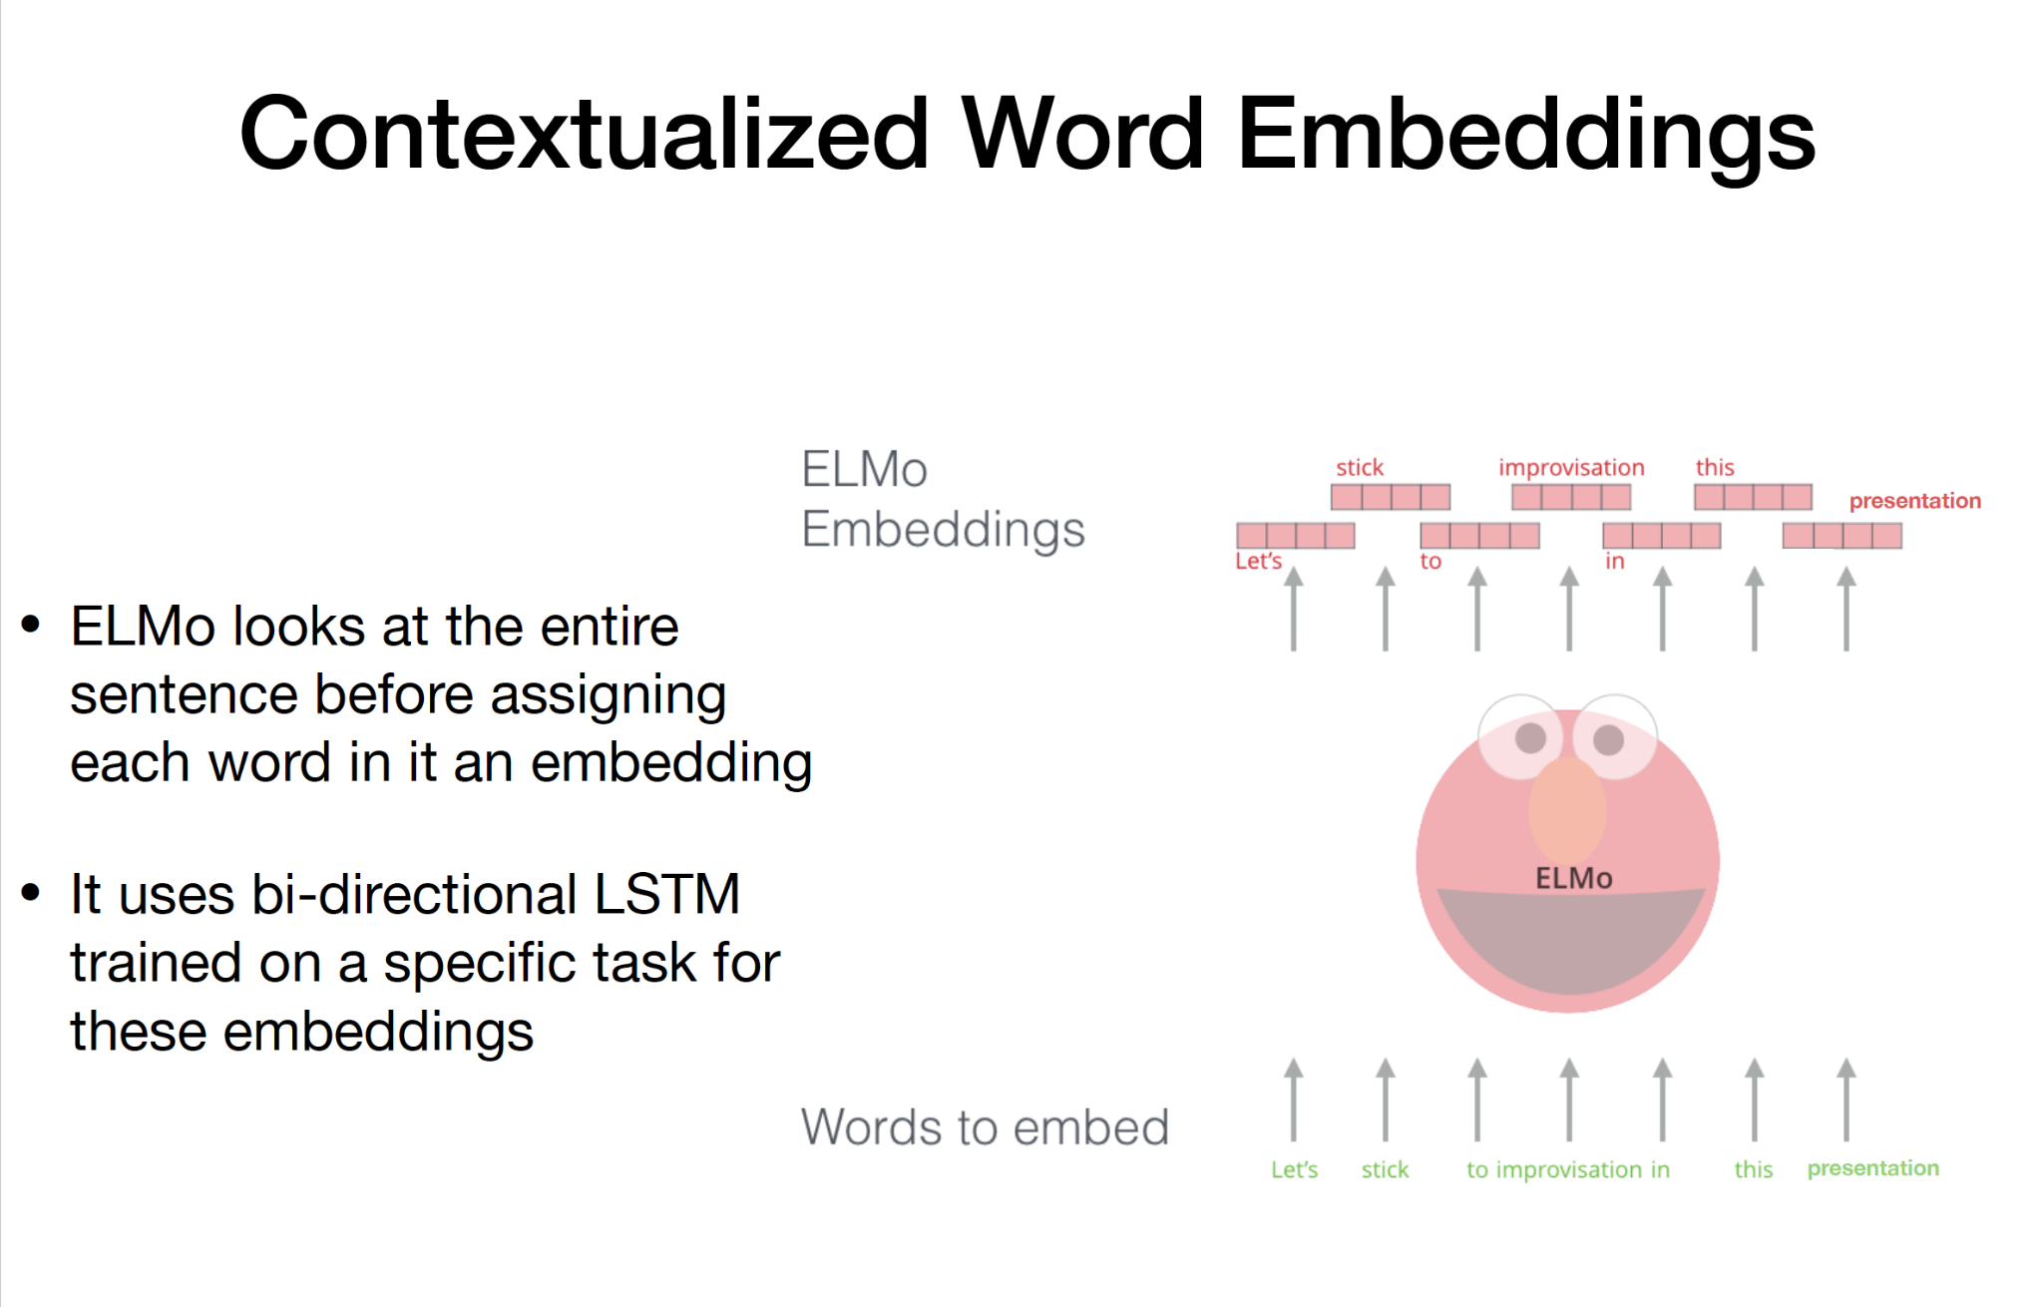
Contextualized Word Embedding

Slide 4
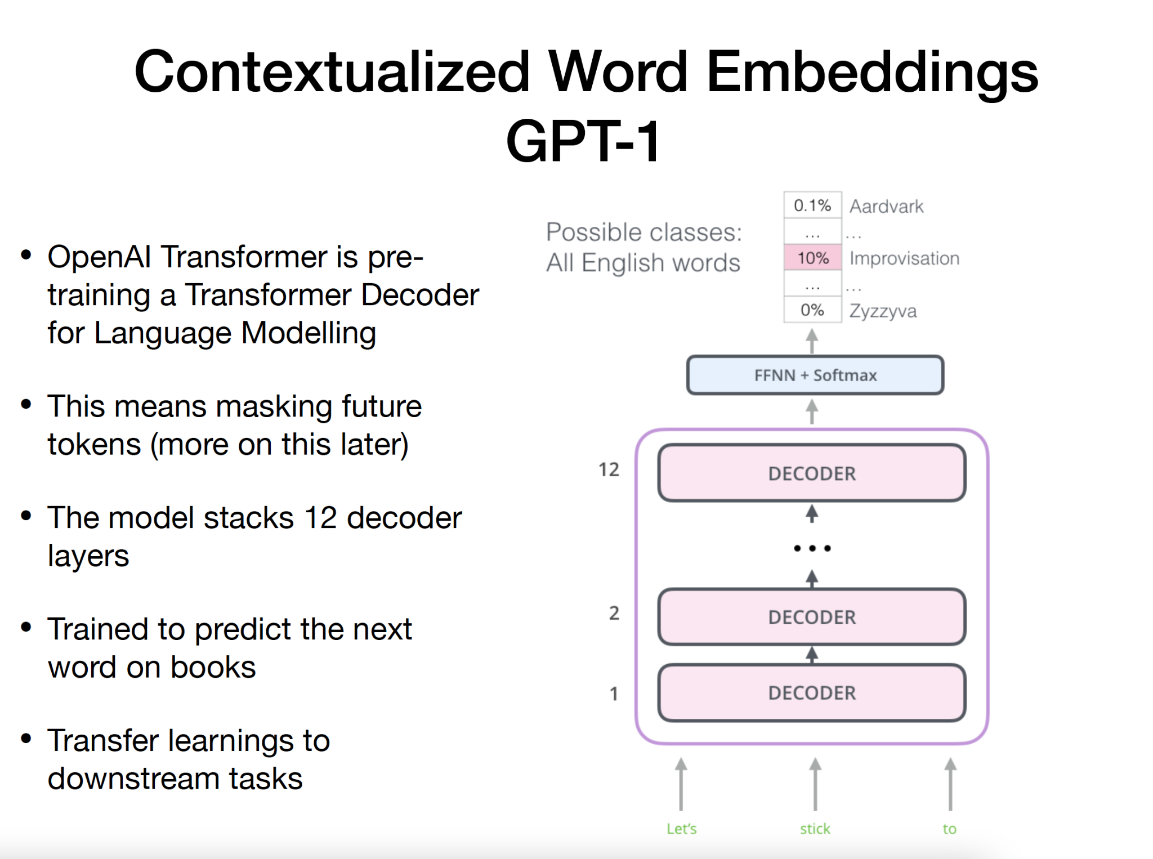
Contextualized Word Embedding GPT-1

Slide 5
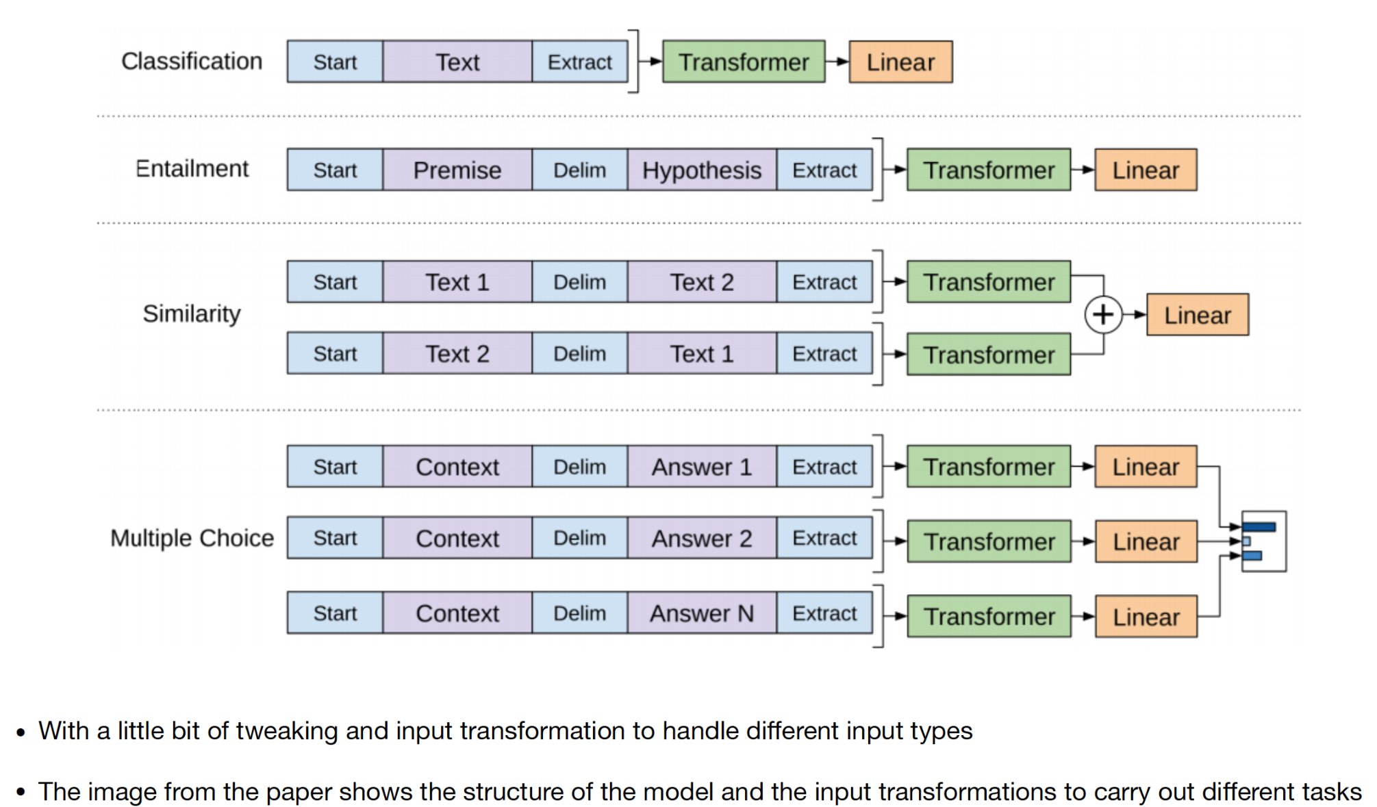
Contextualized Word Embedding GPT-1

Slide 6
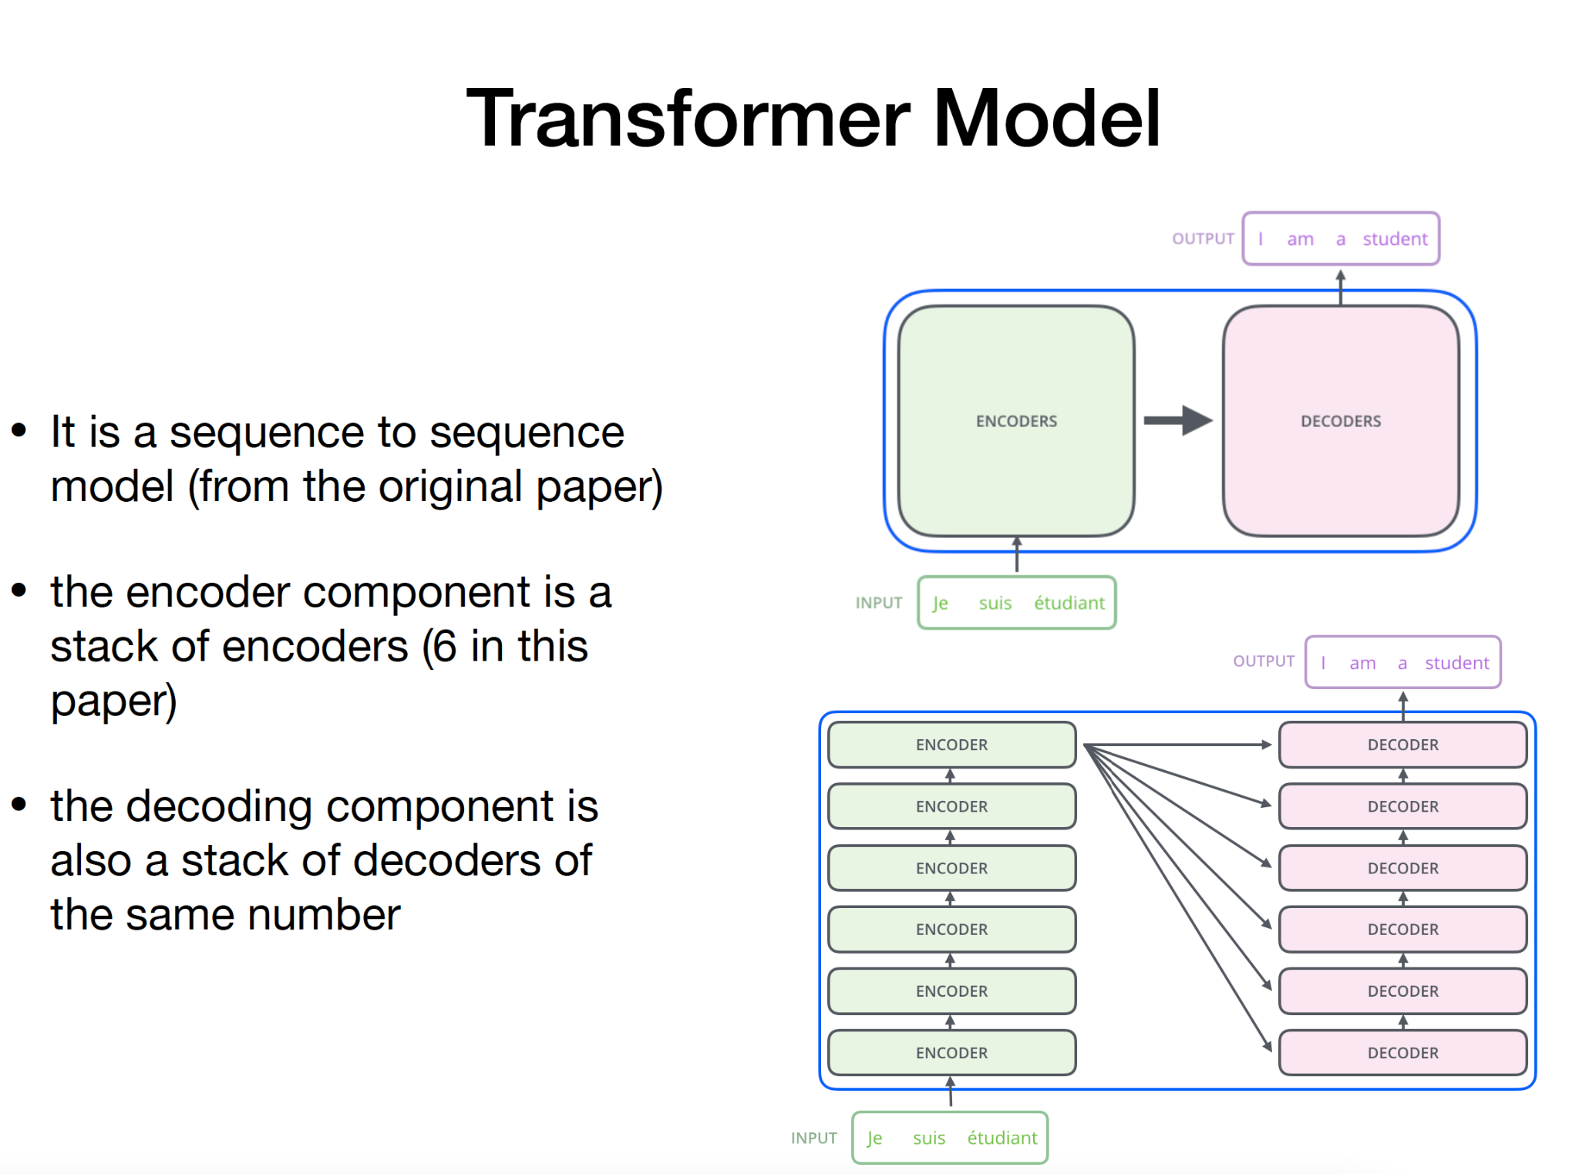
Transformer Model

Slide 7
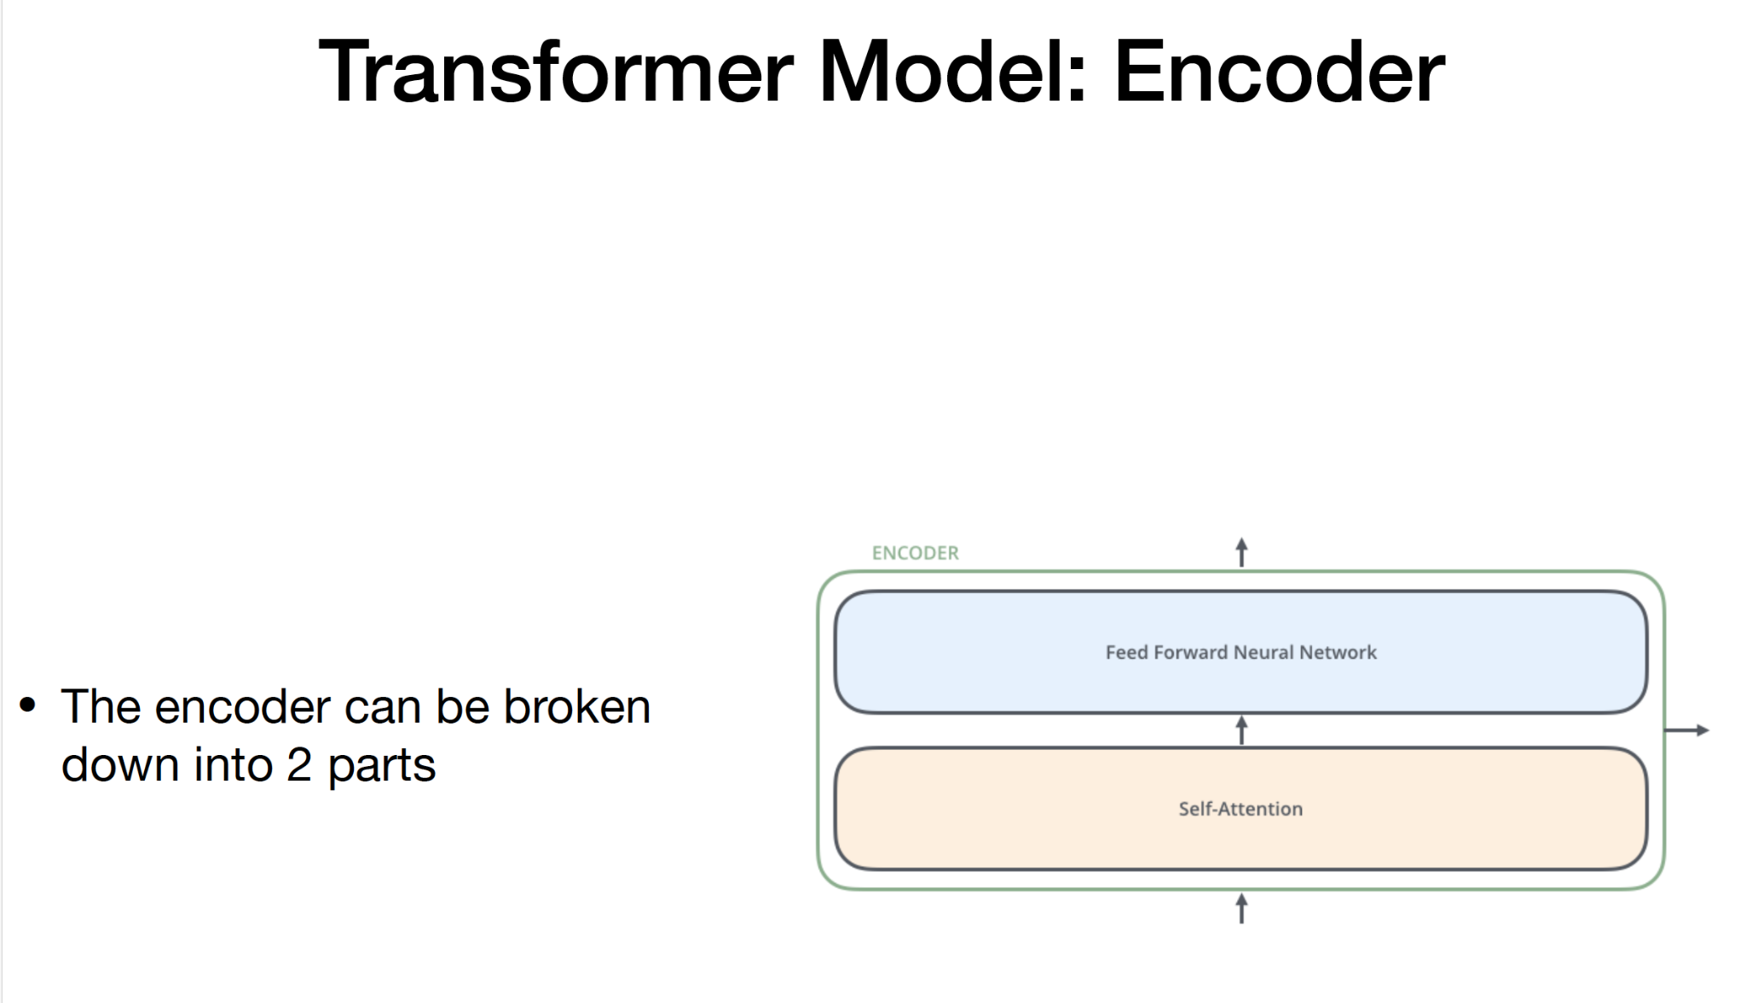
Transformer Model; Encoder

Slide 8
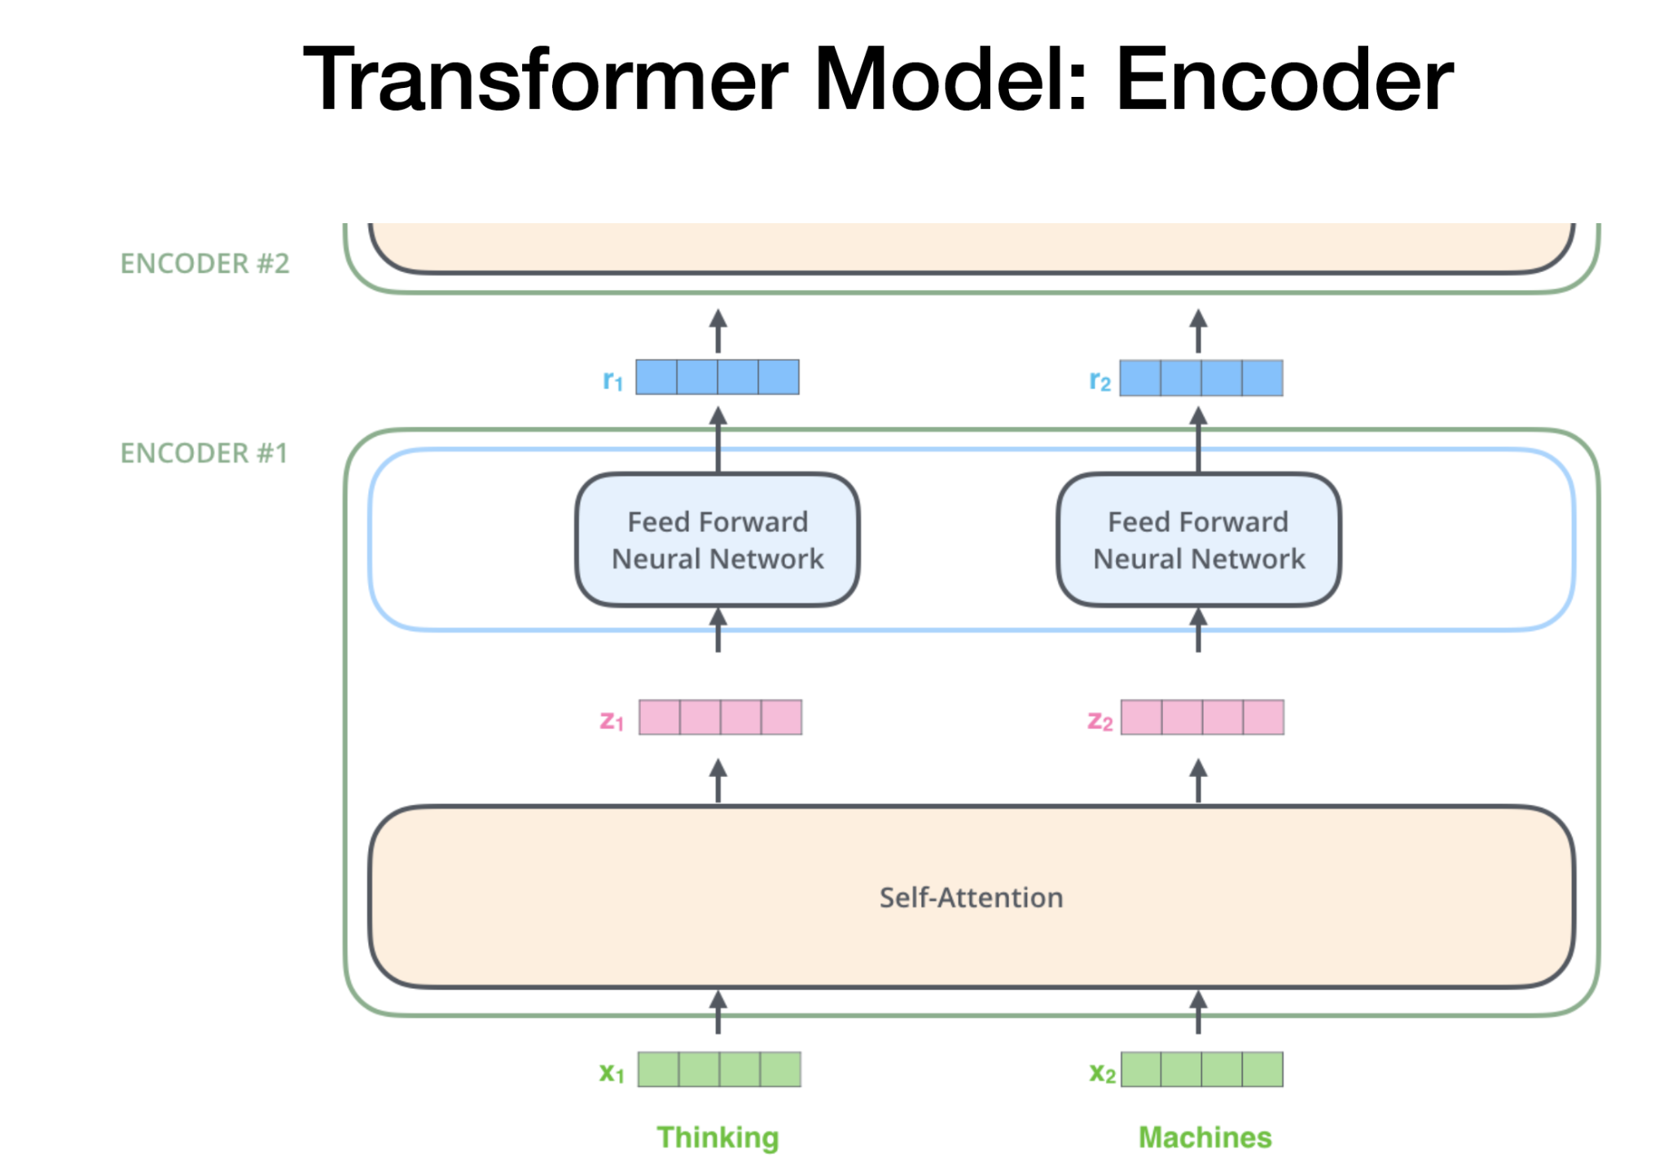
Transformer Model: Encoder

Slide 9
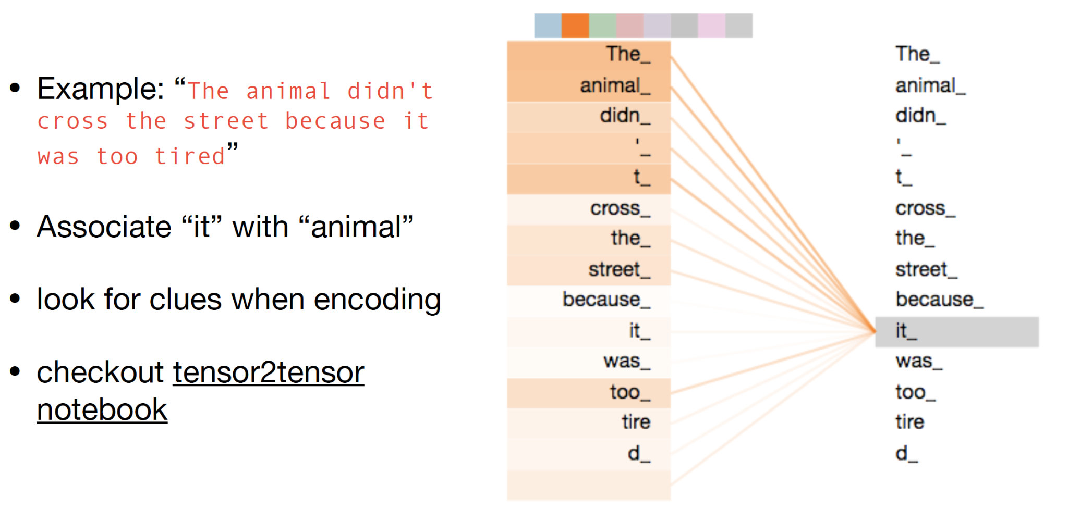
Transformer Model:Encoder Self-Attention

Slide 10
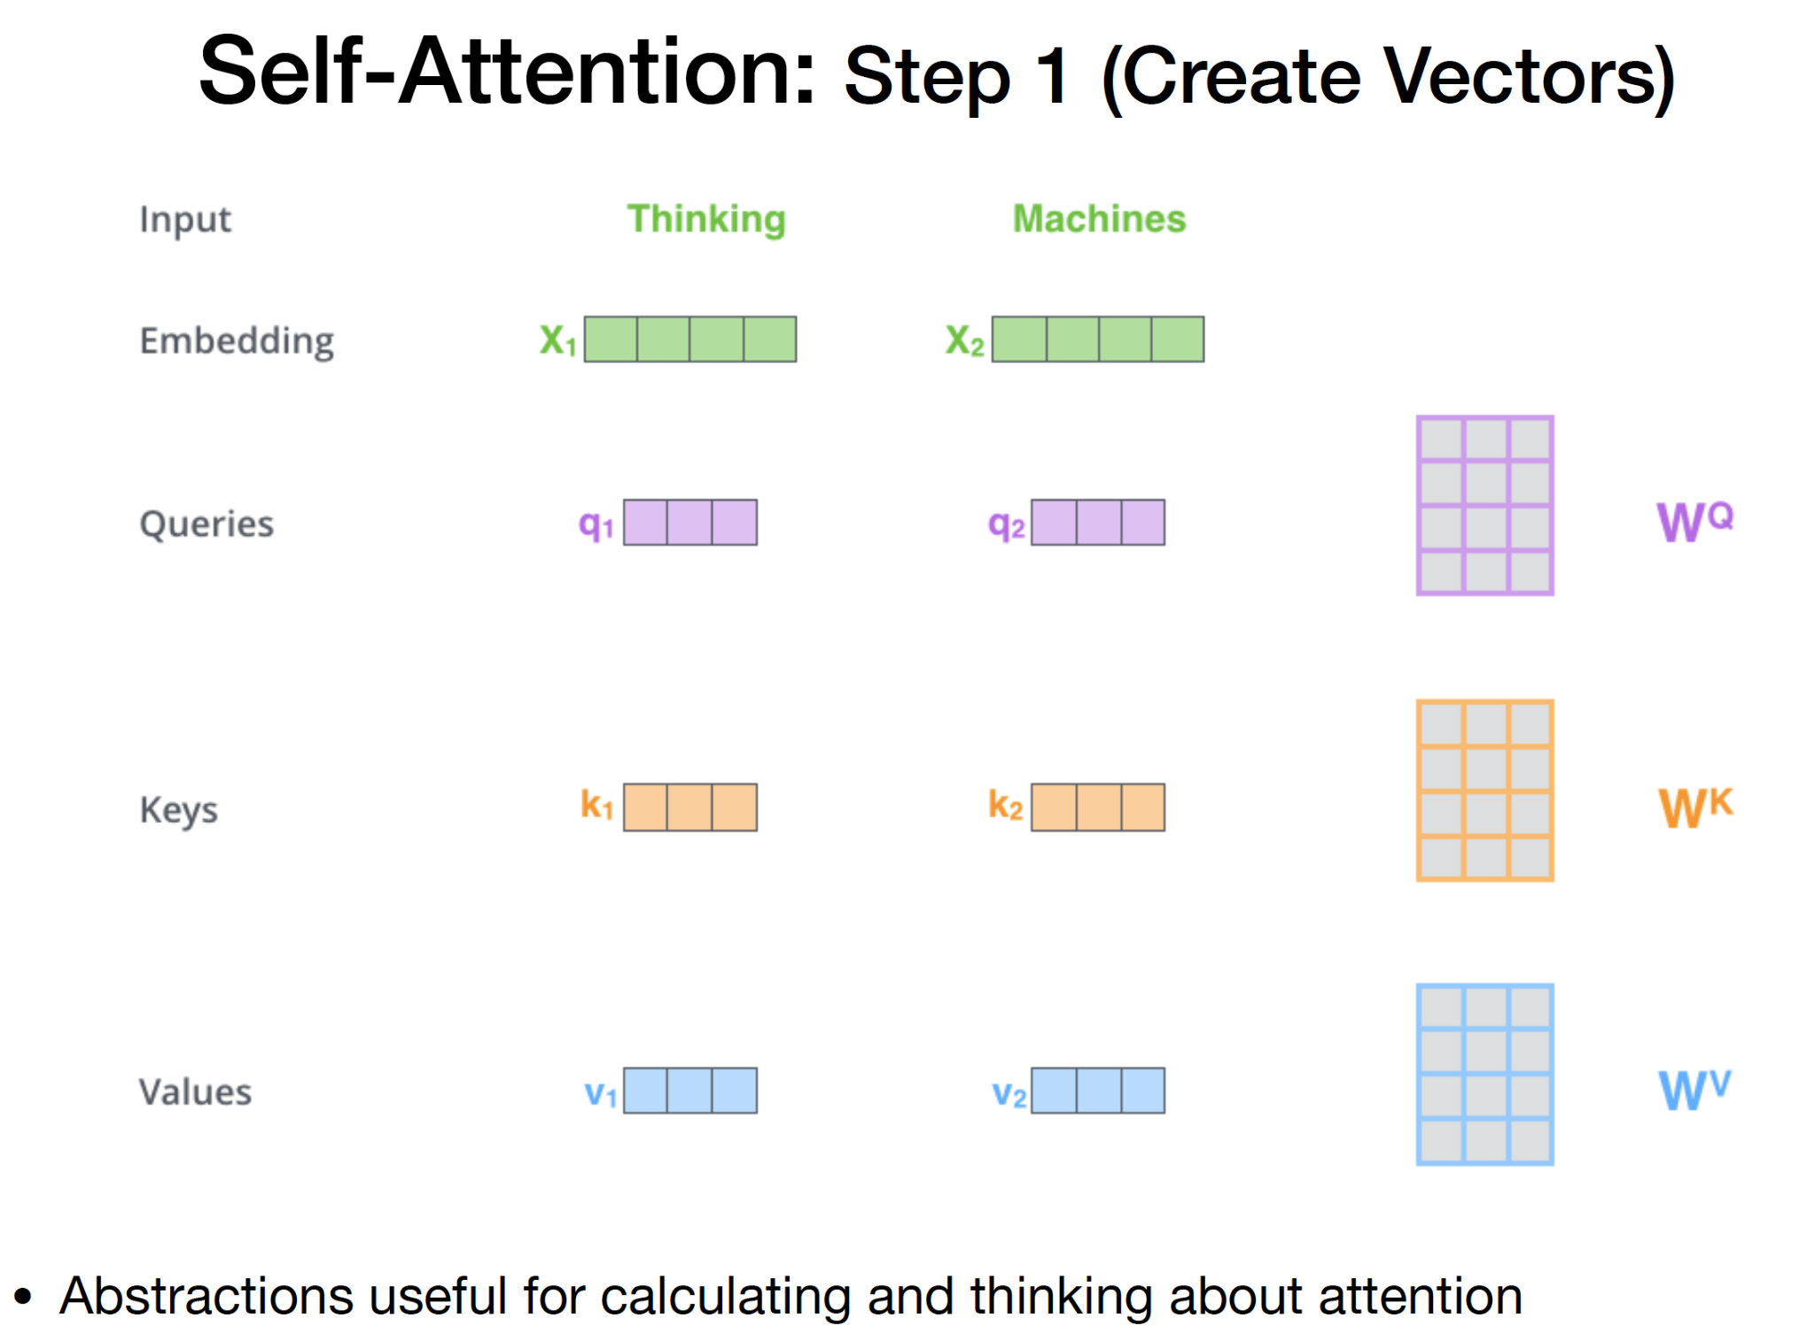
Self-Attention:Step 1 (Create Vector)

Slide 11
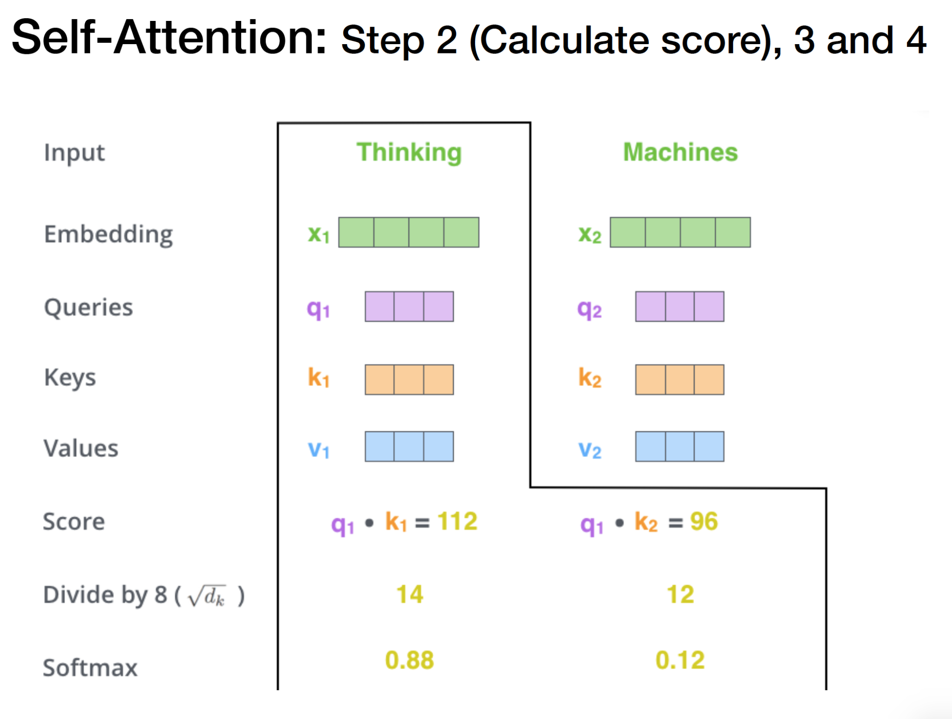
Self-Attention: Step 2(Calculate Score), 3 and 4

Slide 12
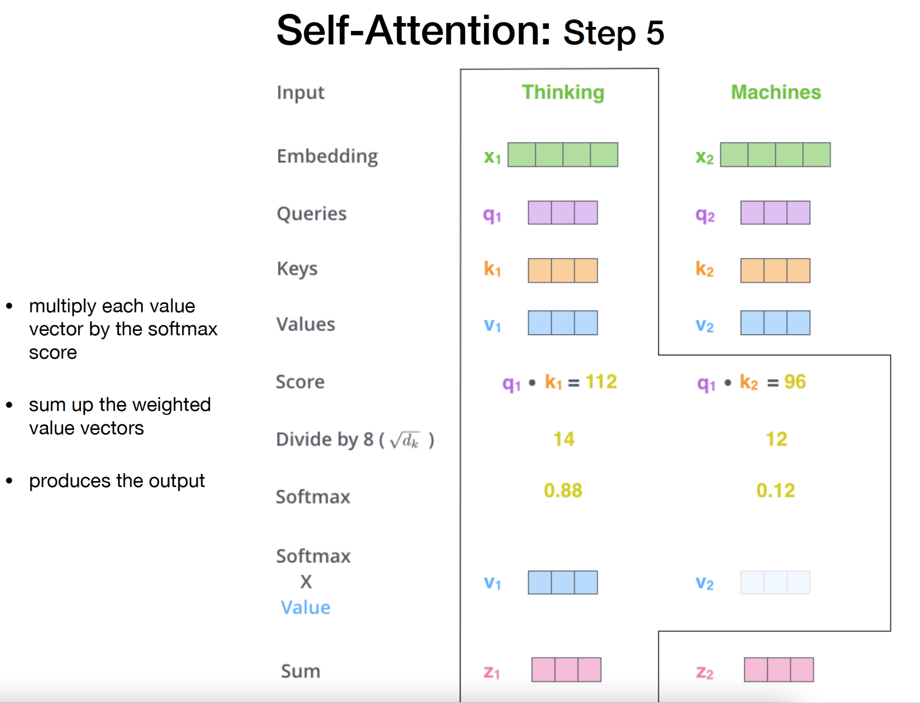
Self-Attention: Step 5

Slide 13
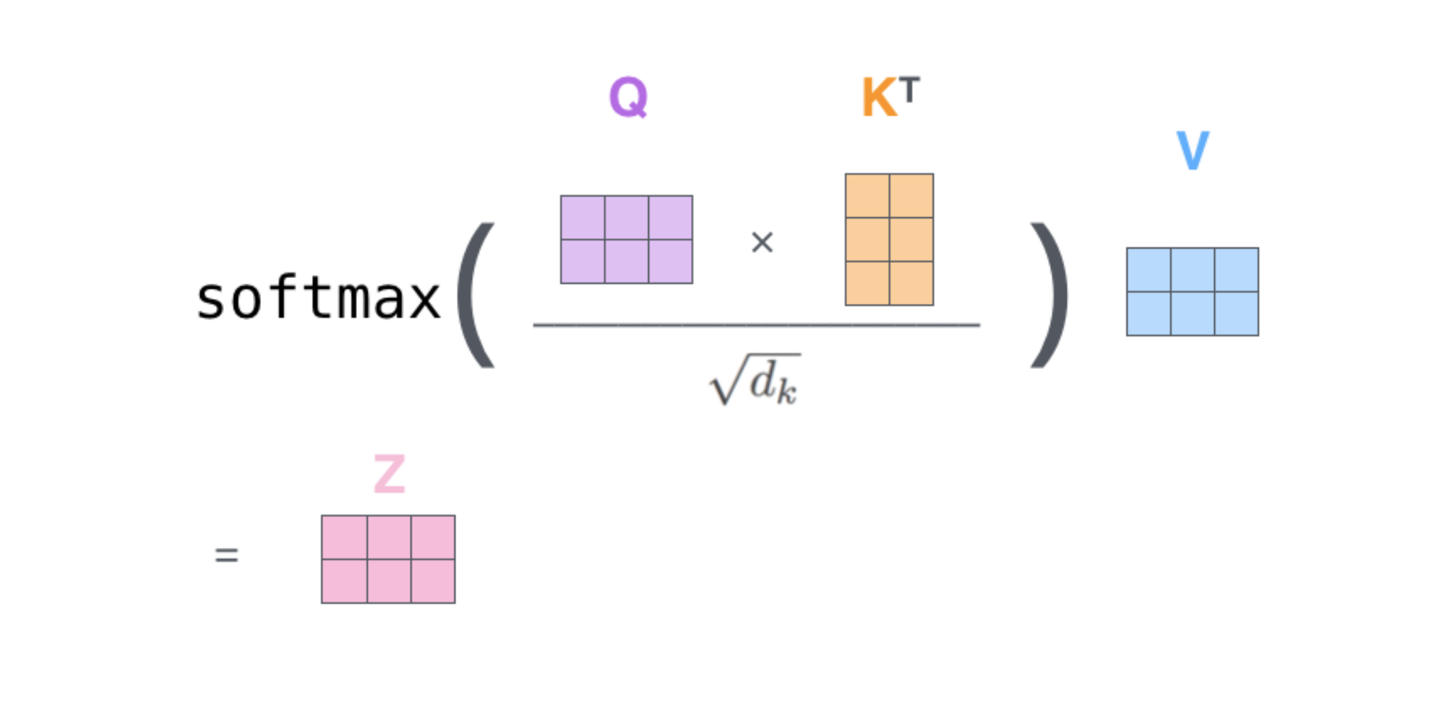
Self-Attention: Matrix Form

Slide 14
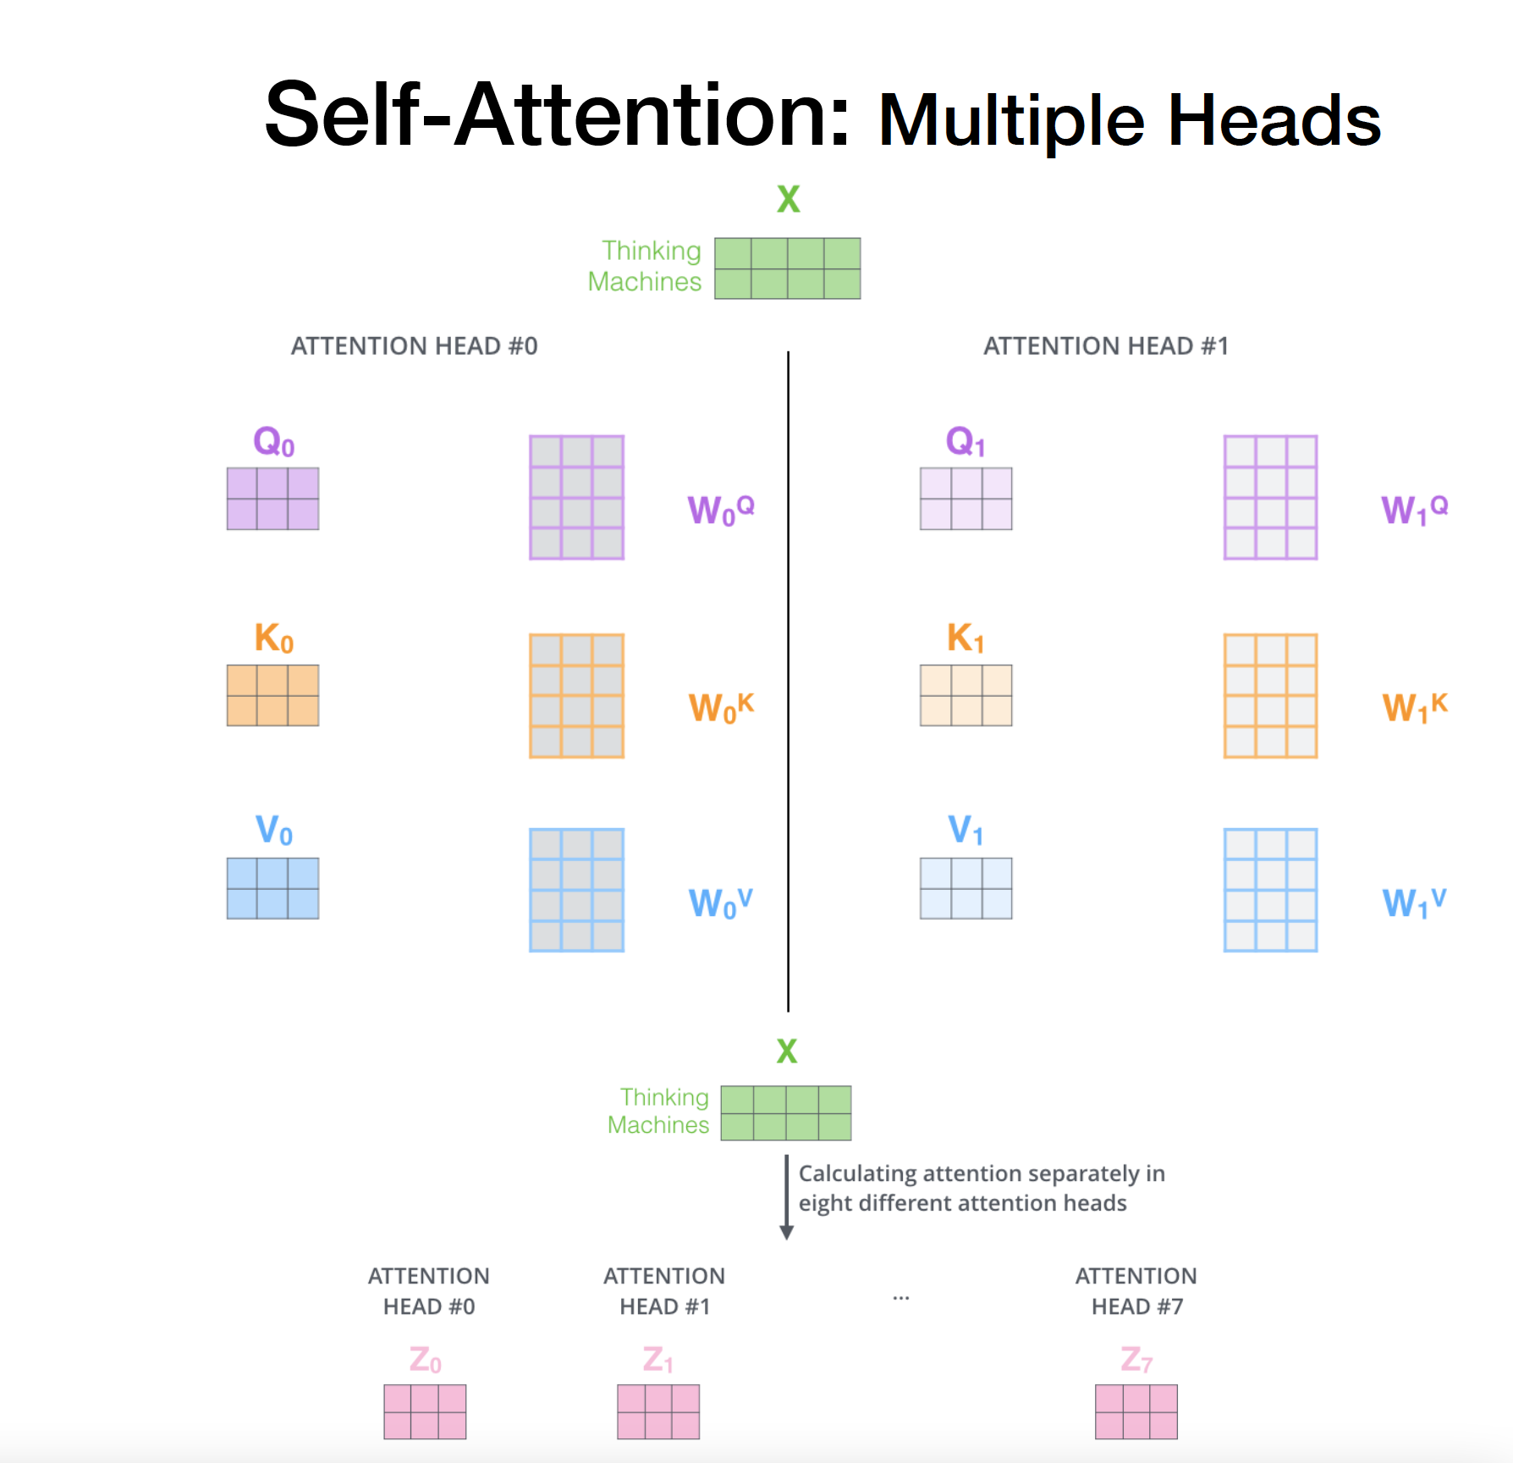
Self-Attention:Multiple Heads

Slide 15
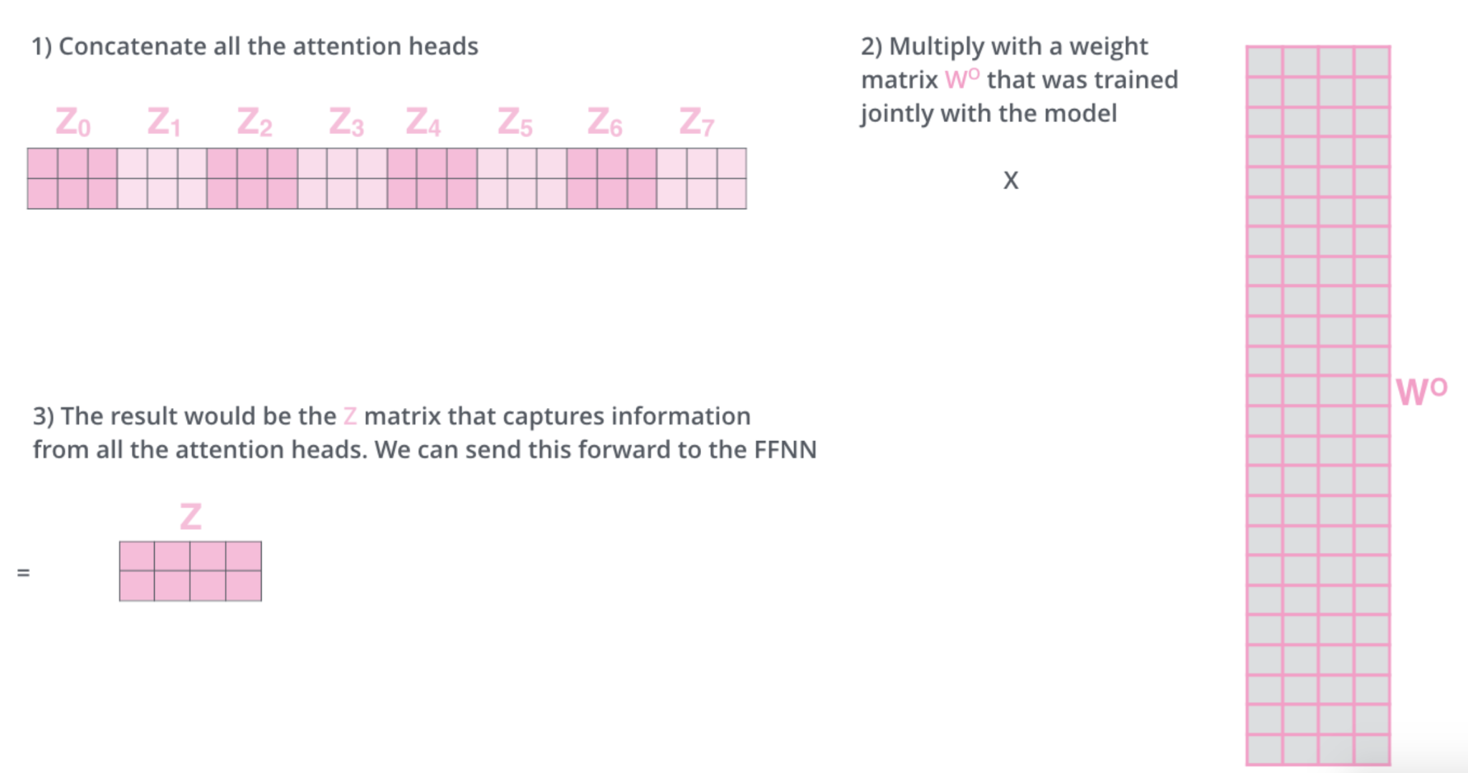
Self-Attention: Multiple Heads

Slide 16
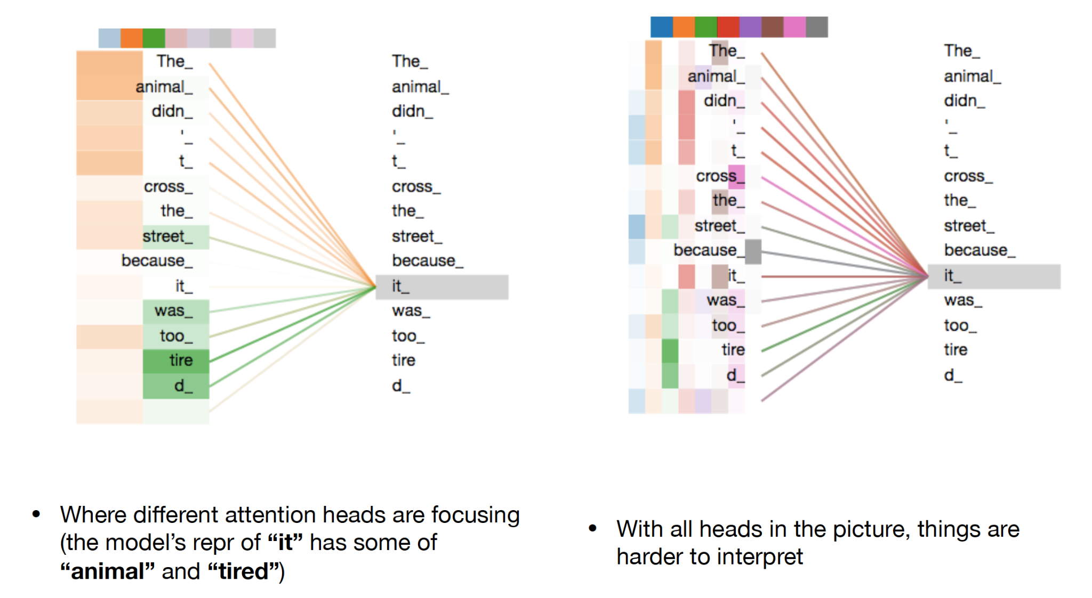
Self-Attention: Multiple Heads

Slide 17
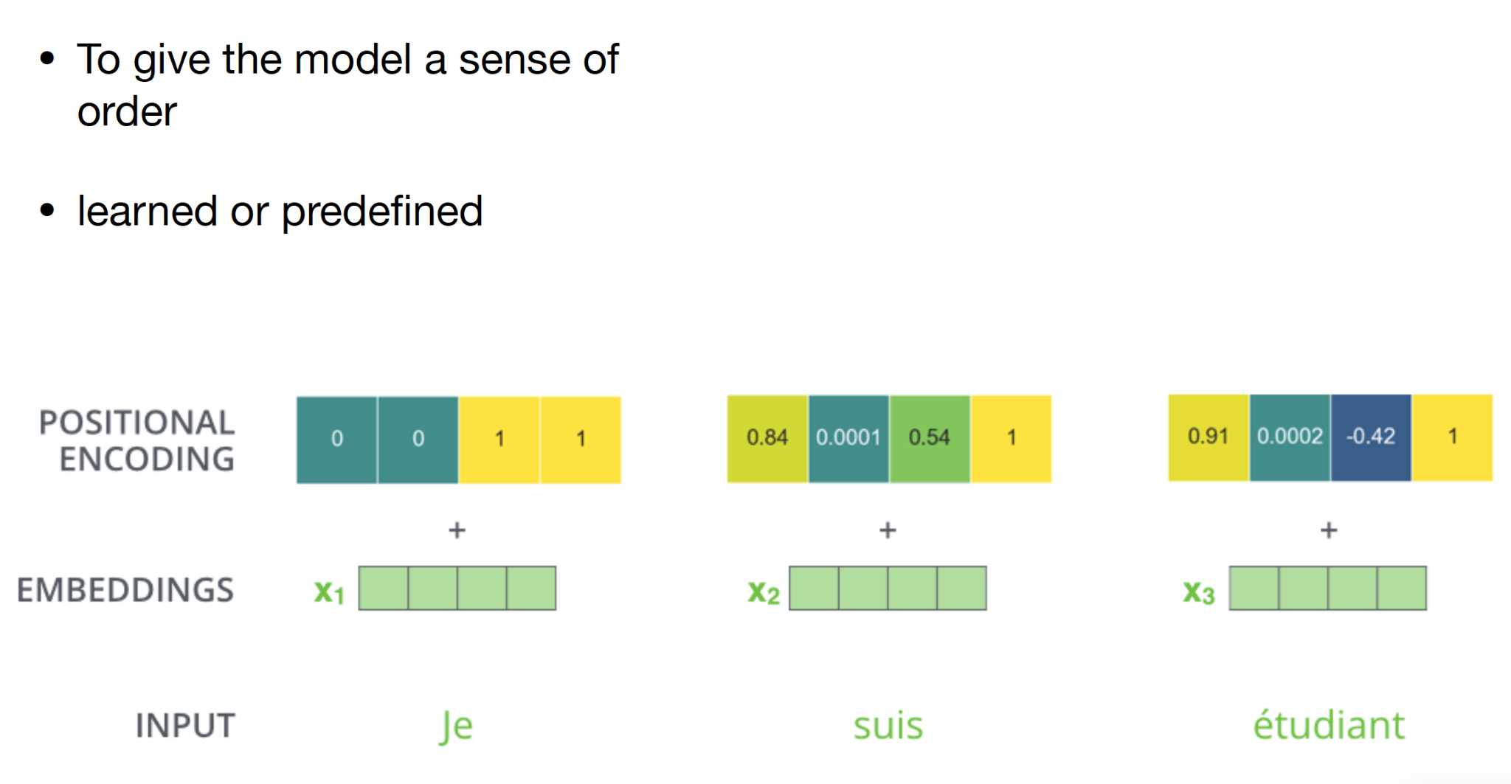
Positional Embeddings

Slide 18
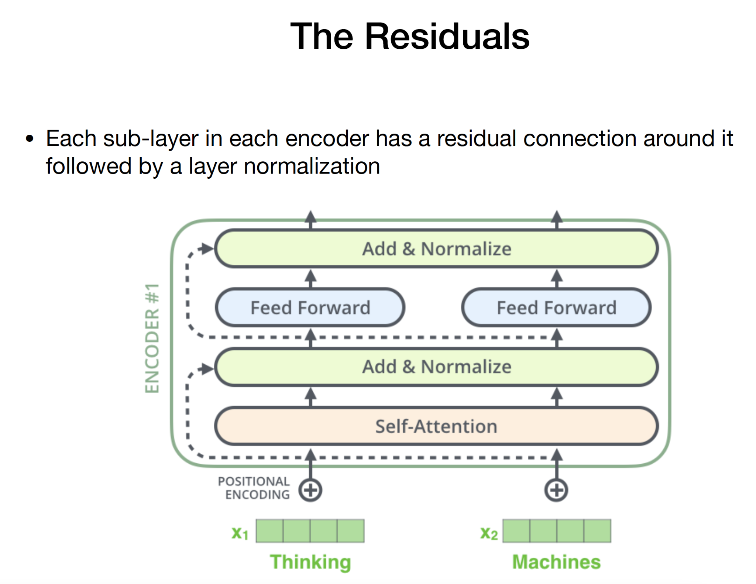
The Residuals

Slide 19
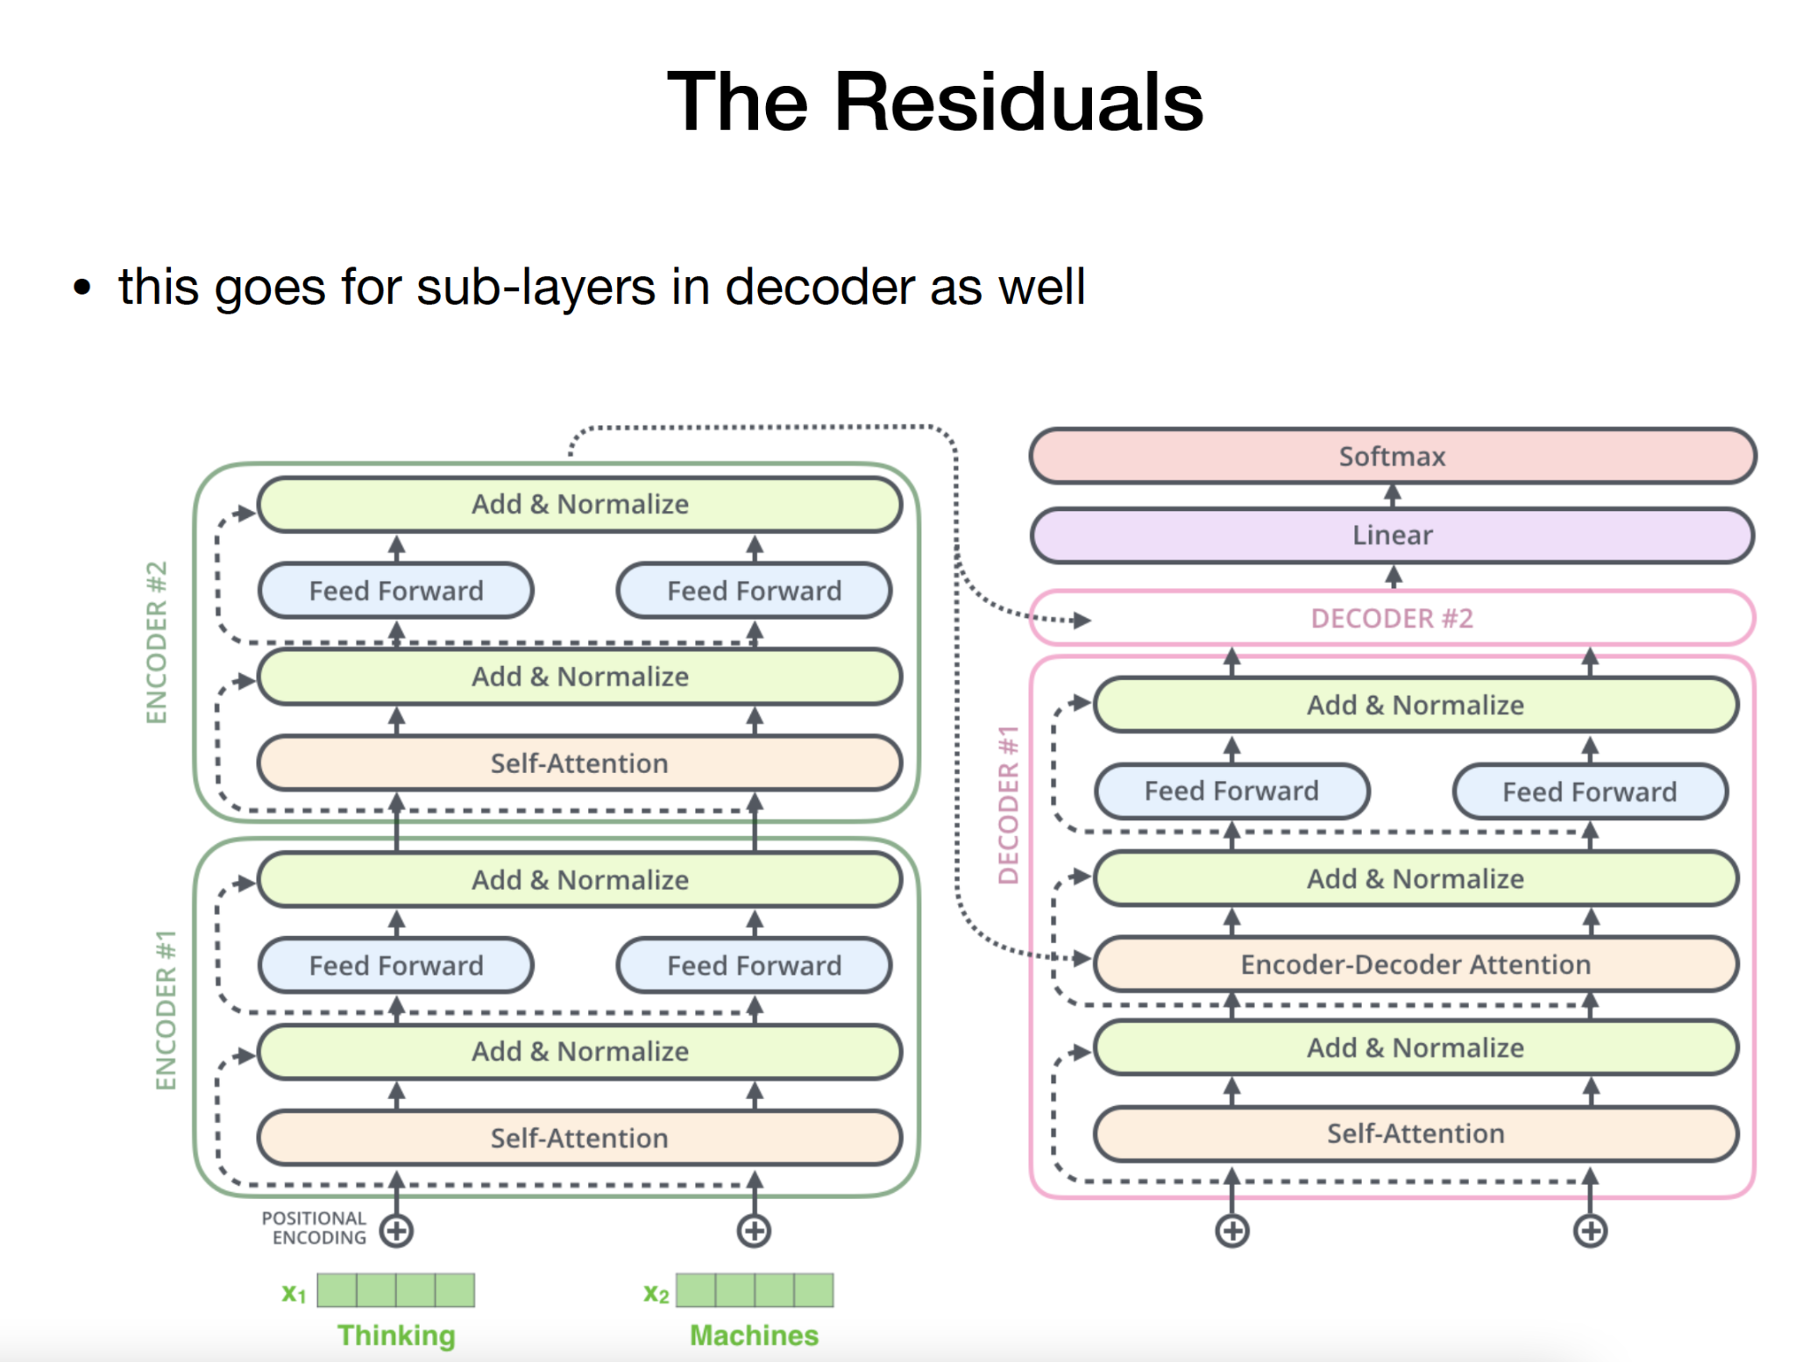
The Residuals

Slide 20
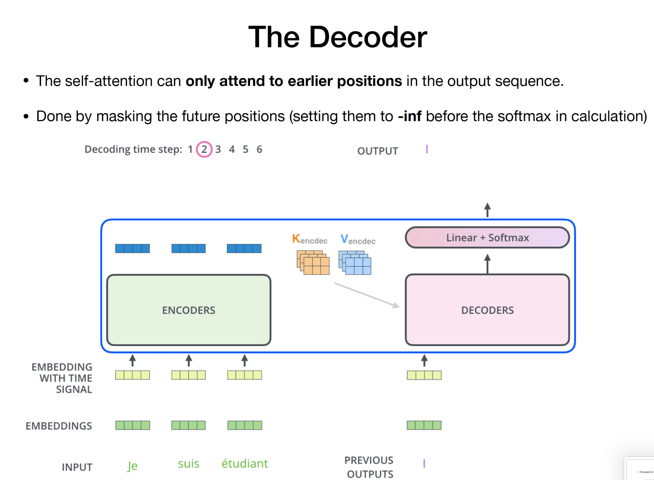
The Decoder

Slide 21
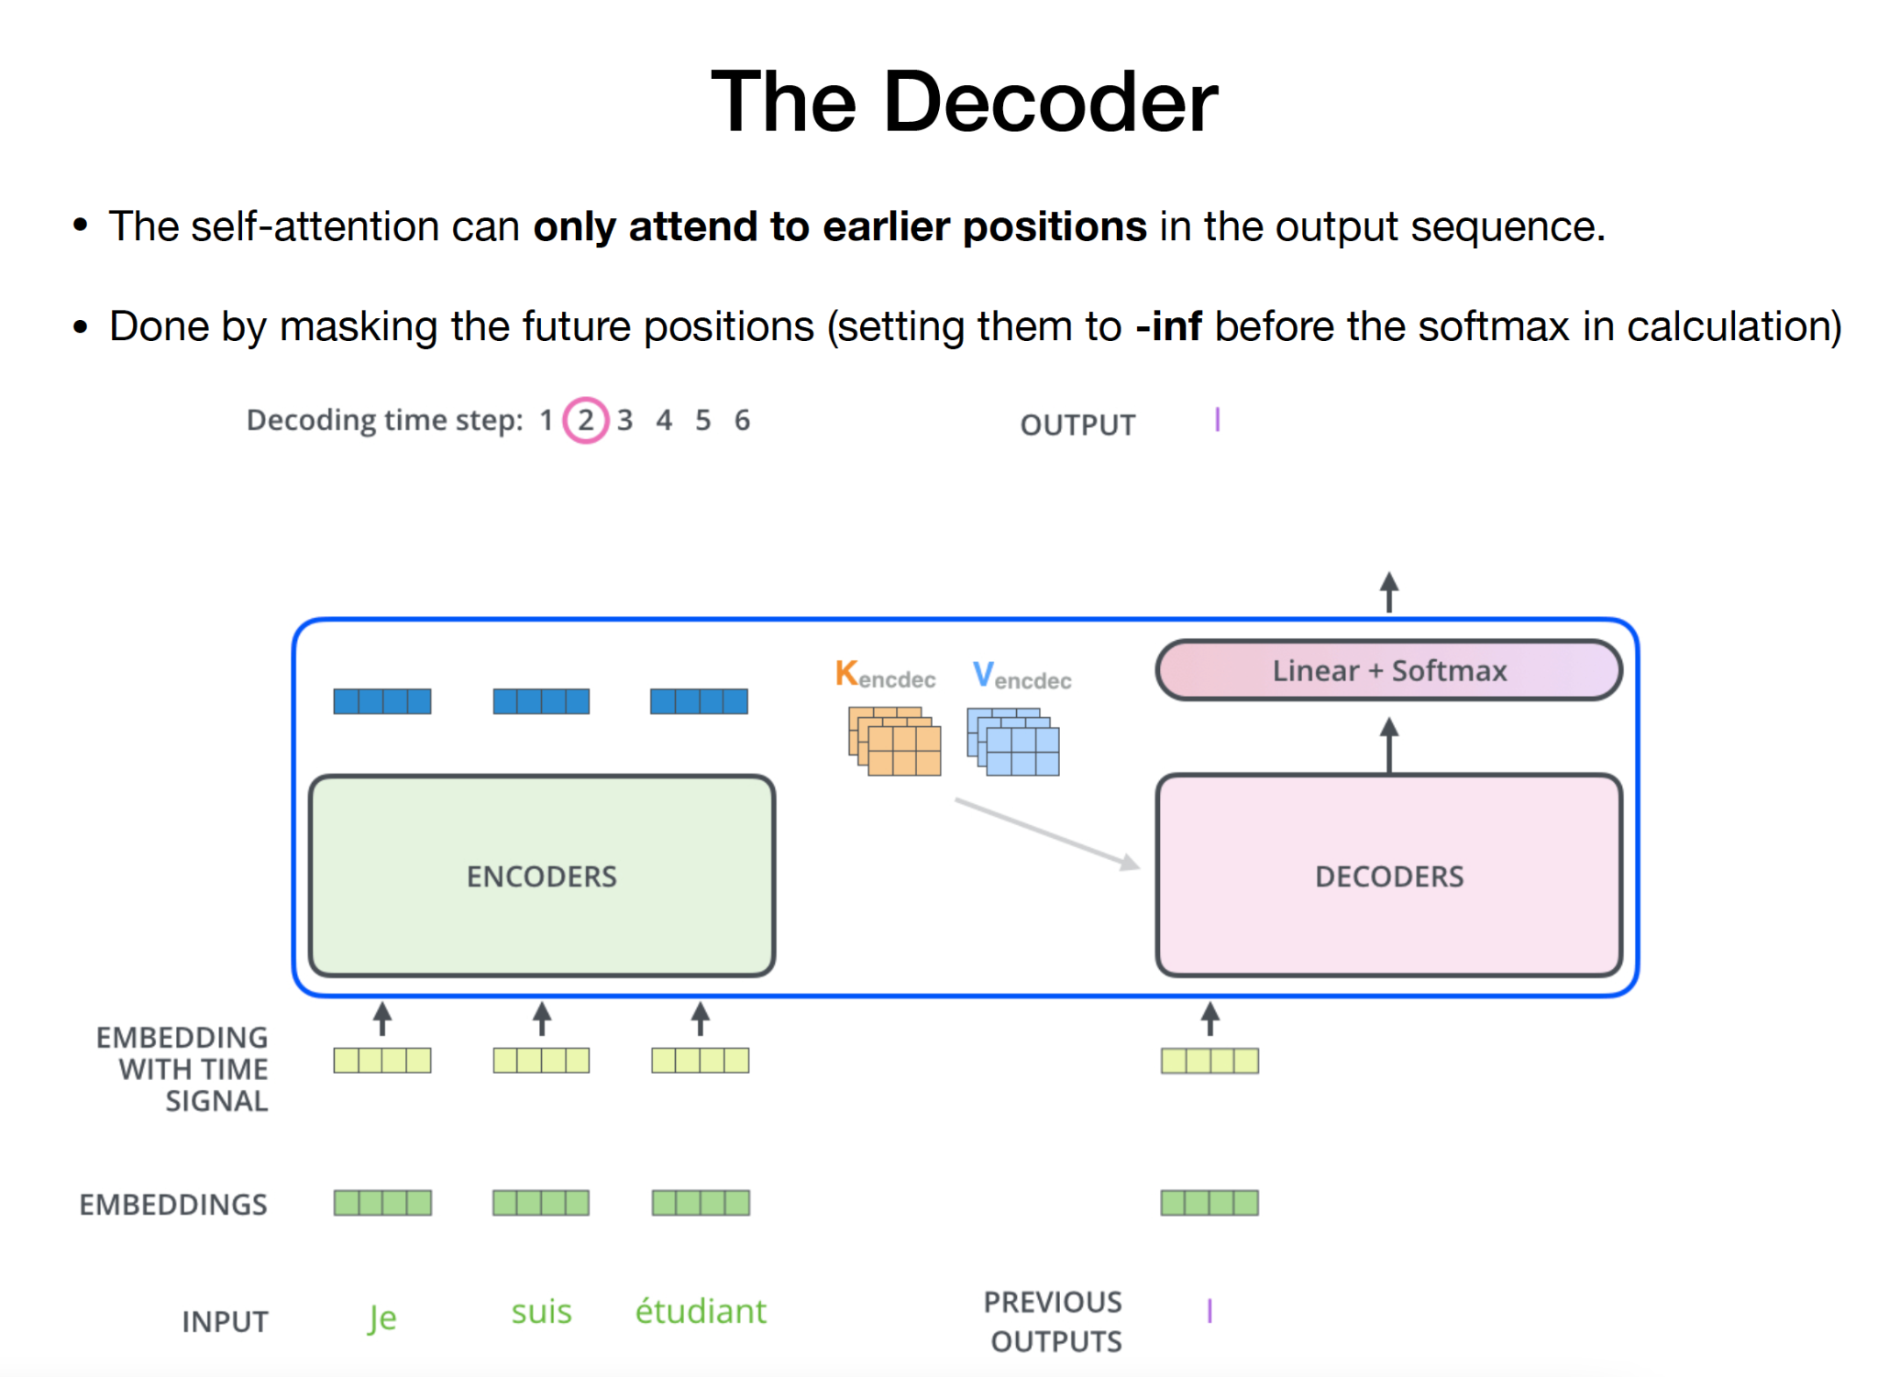
The Decoder

Slide 22
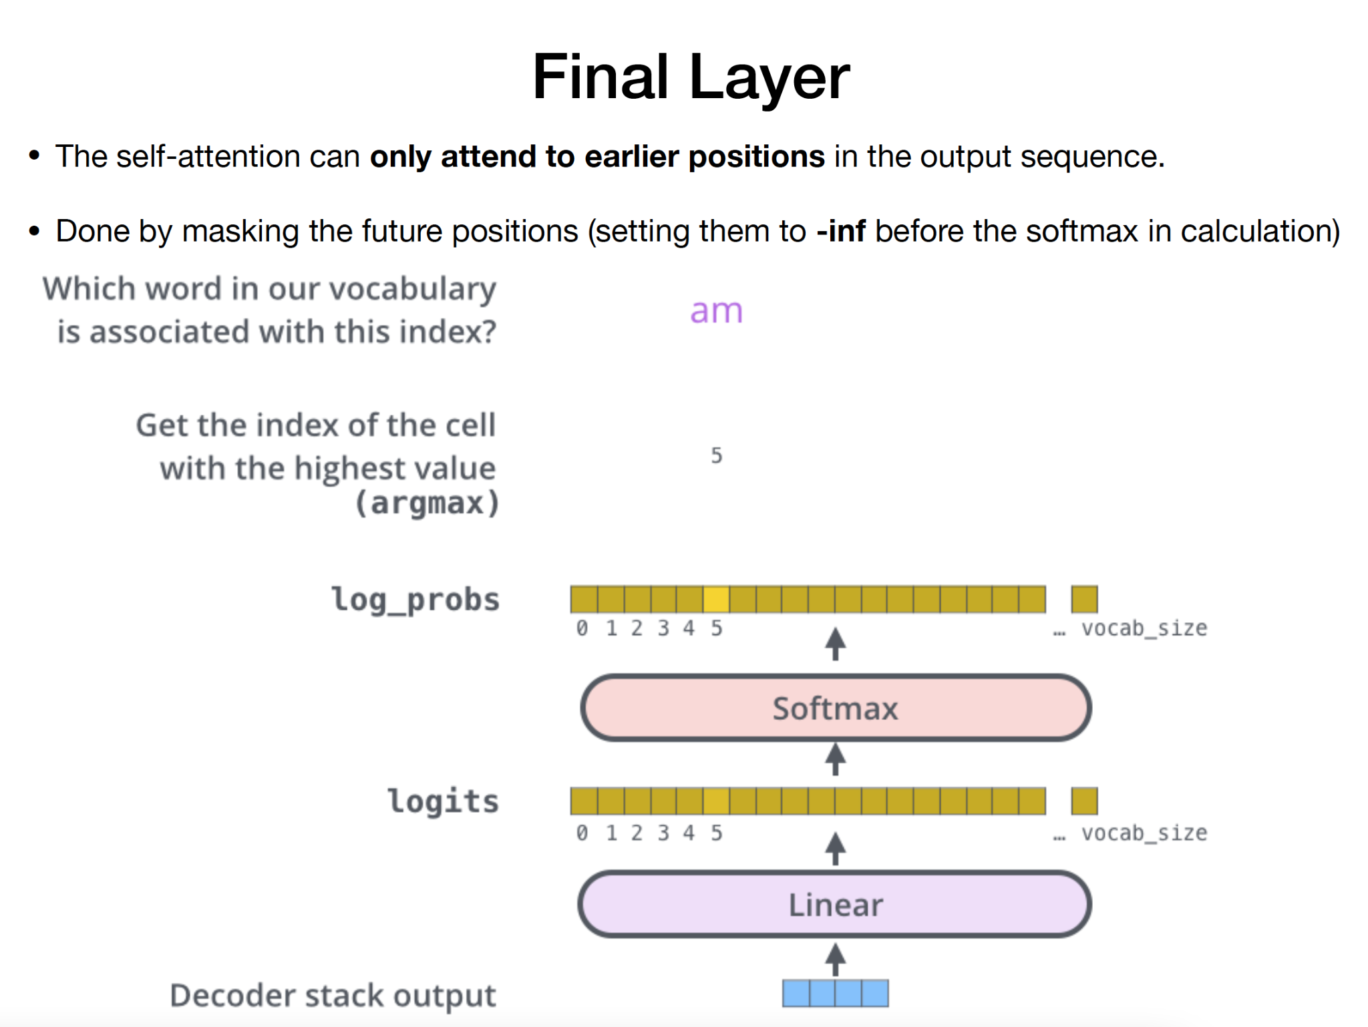
Final Layer

Slide 23
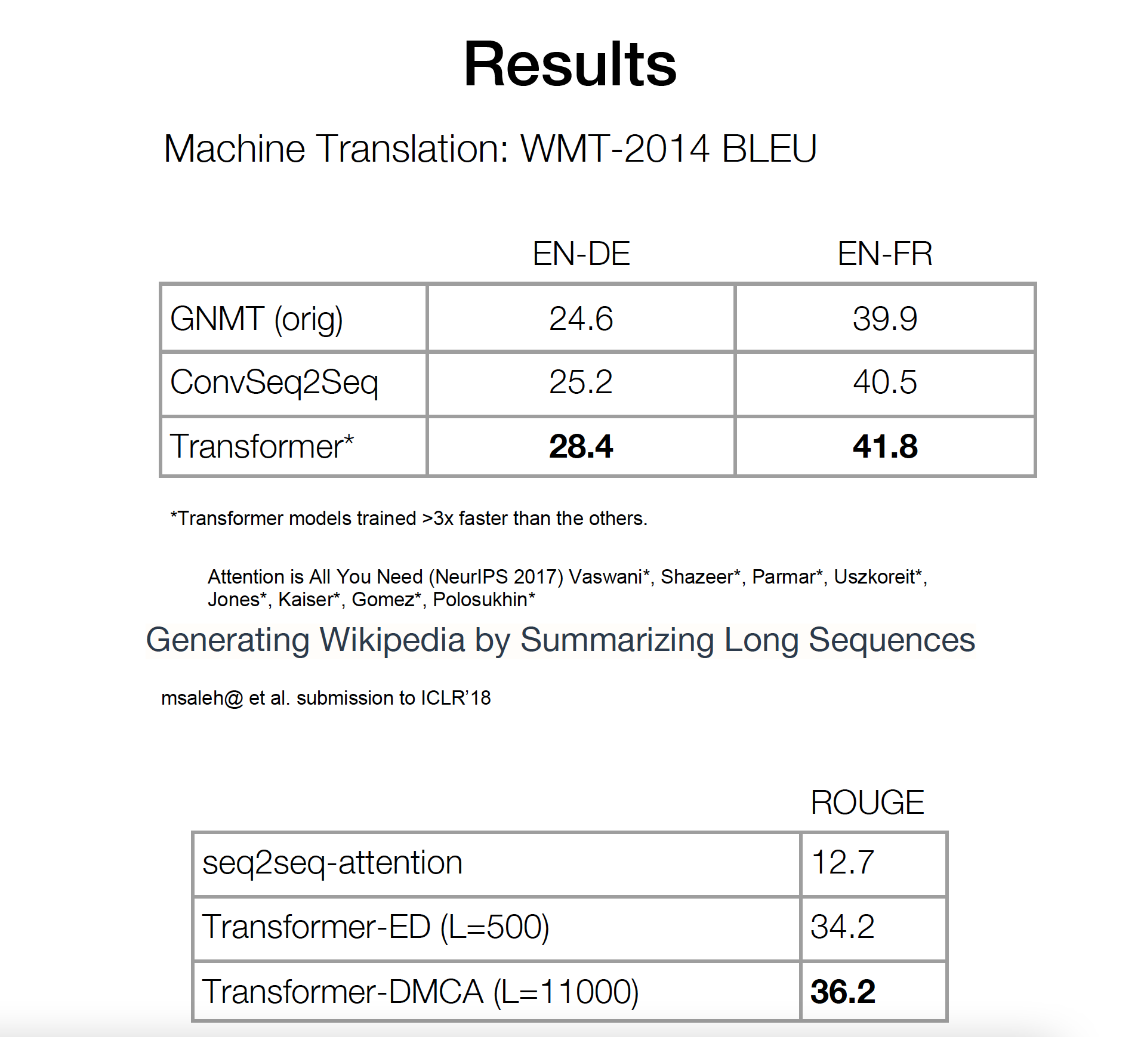
Results

Slide 24
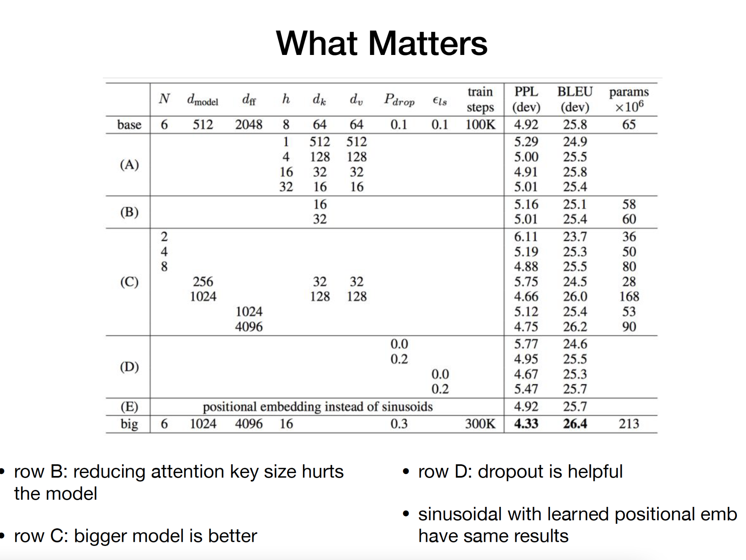
What Matters

Slide 25
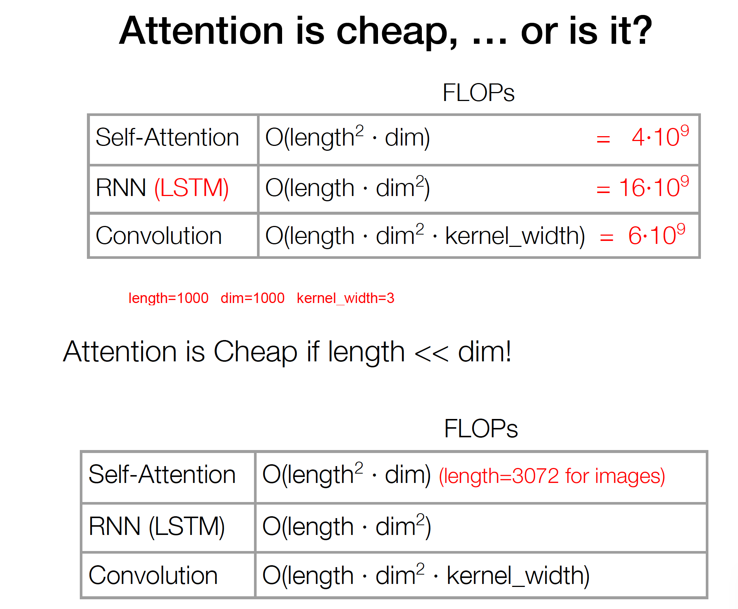
Attention is cheap, .. or is it?

Slide 26
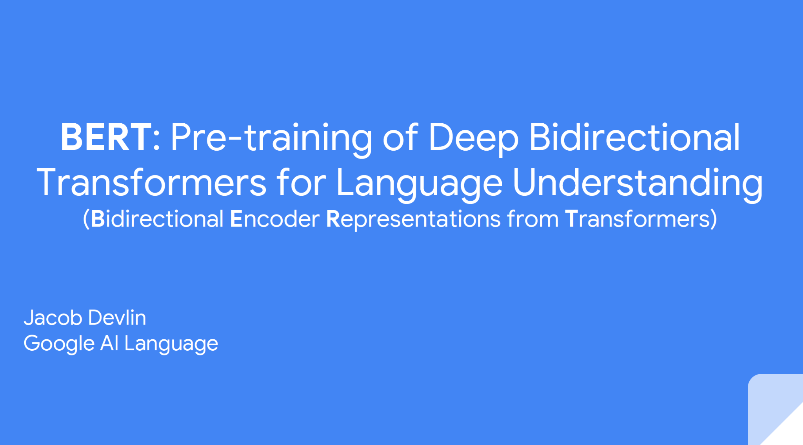
BERT

Slide 27
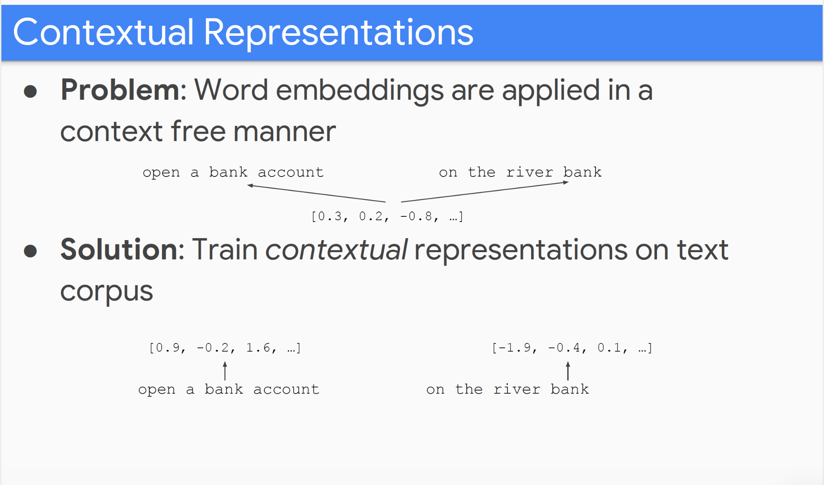
Contextual Representation

Slide 28
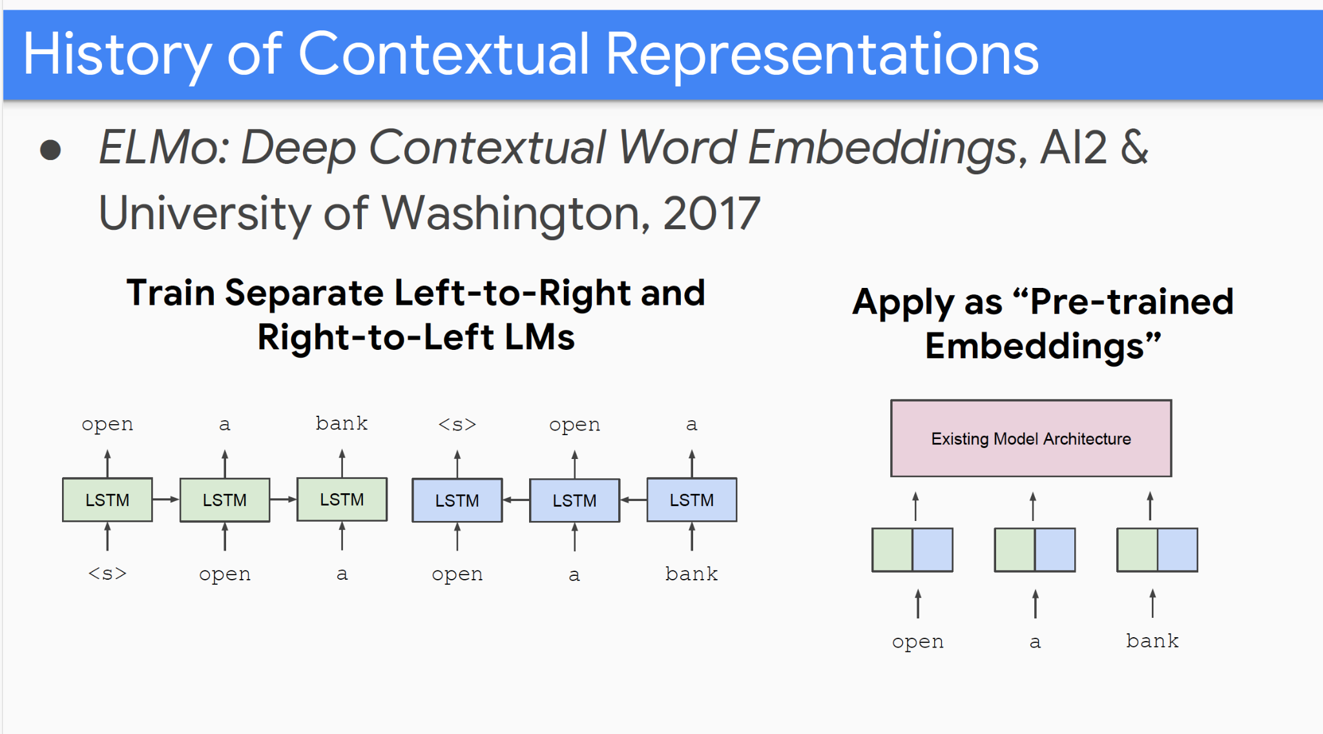
History of Contextual Representation

Slide 29
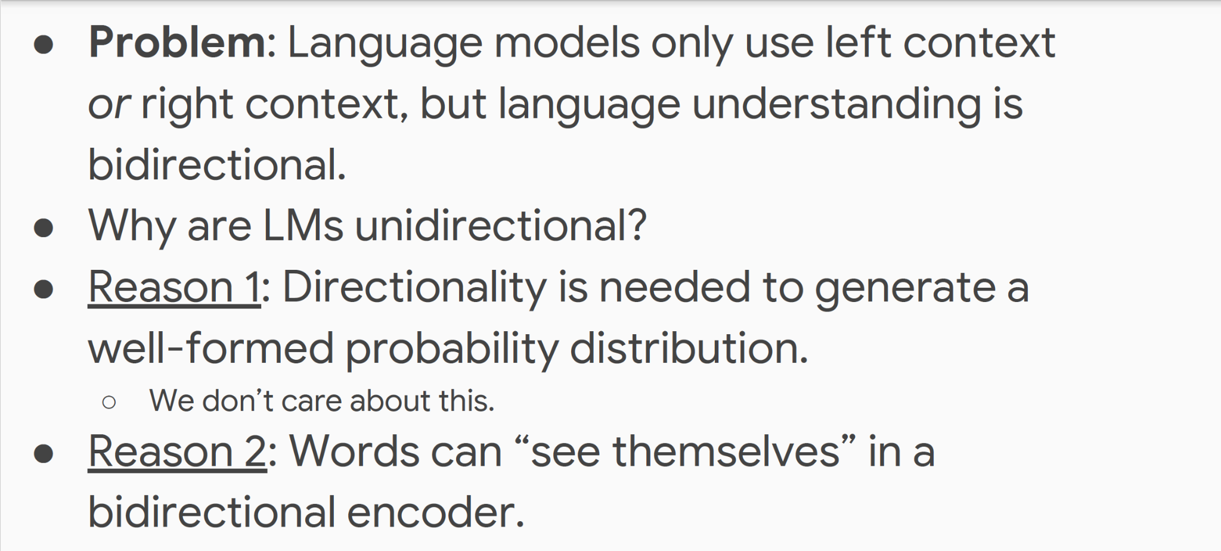
Problem with Previous Methods

Slide 30
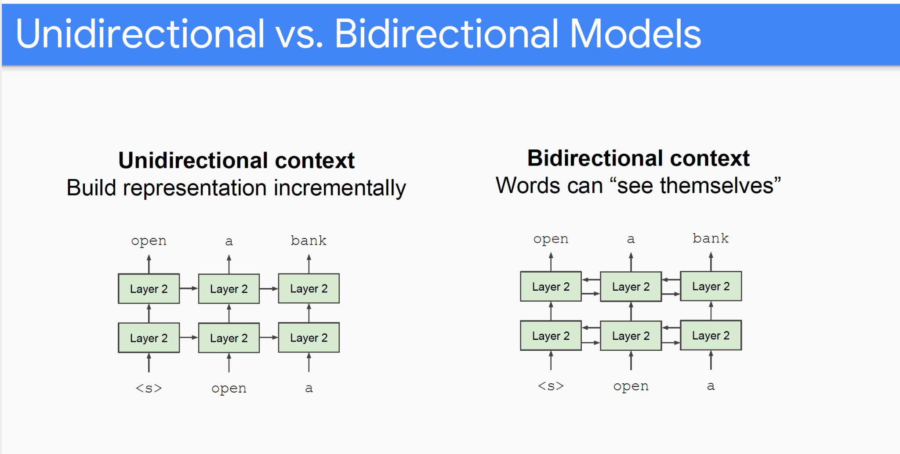
Unidirectional vs. Bidirectional Models

Slide 31
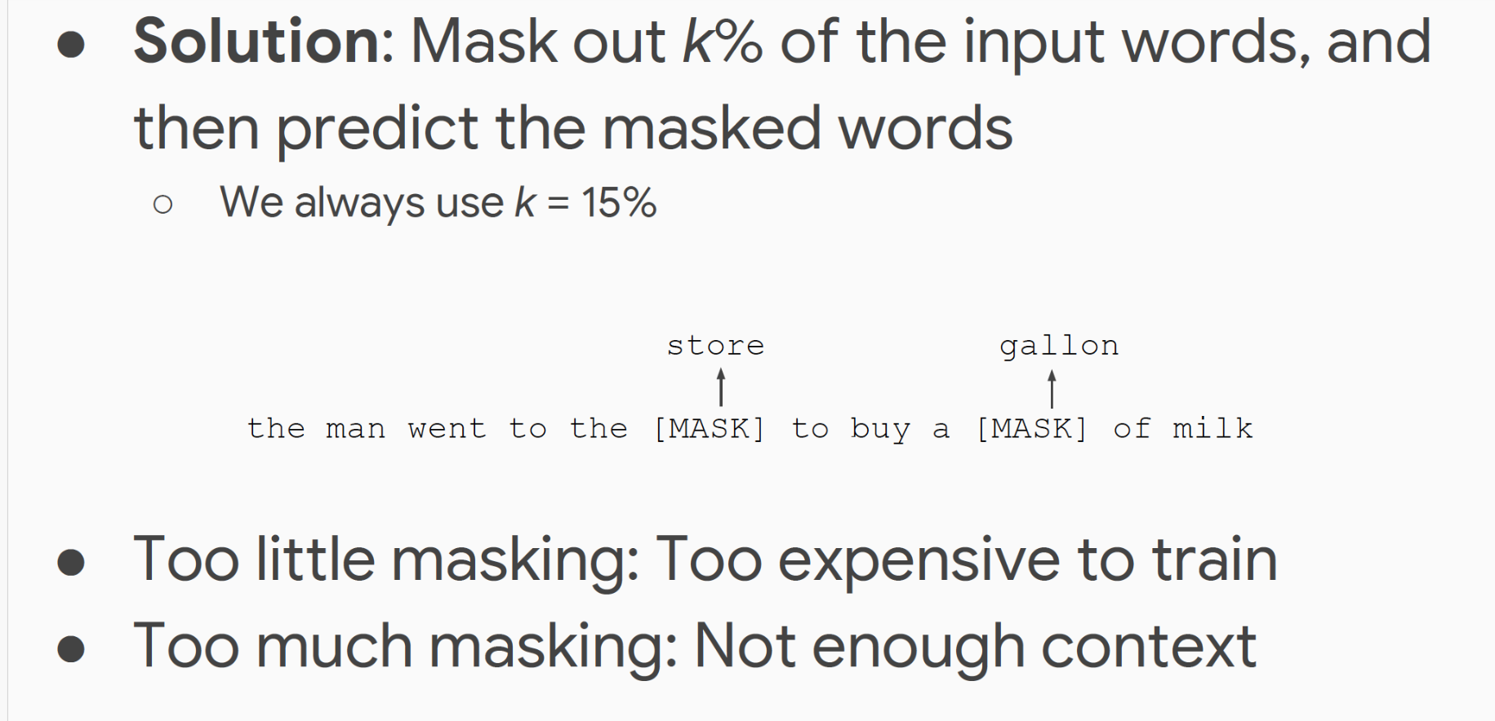
Masked LM

Slide 32
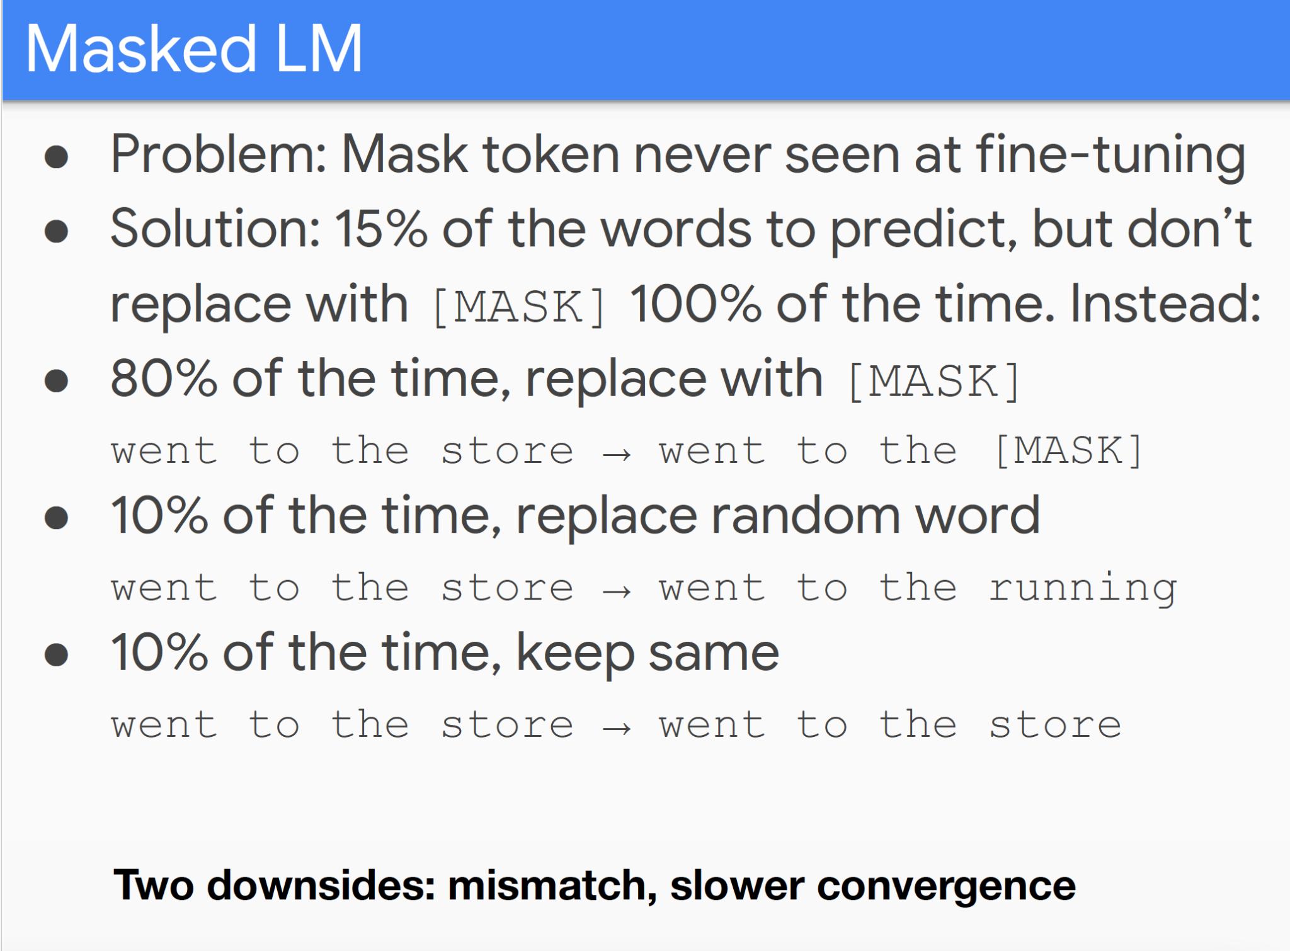
Masked LM

Slide 33
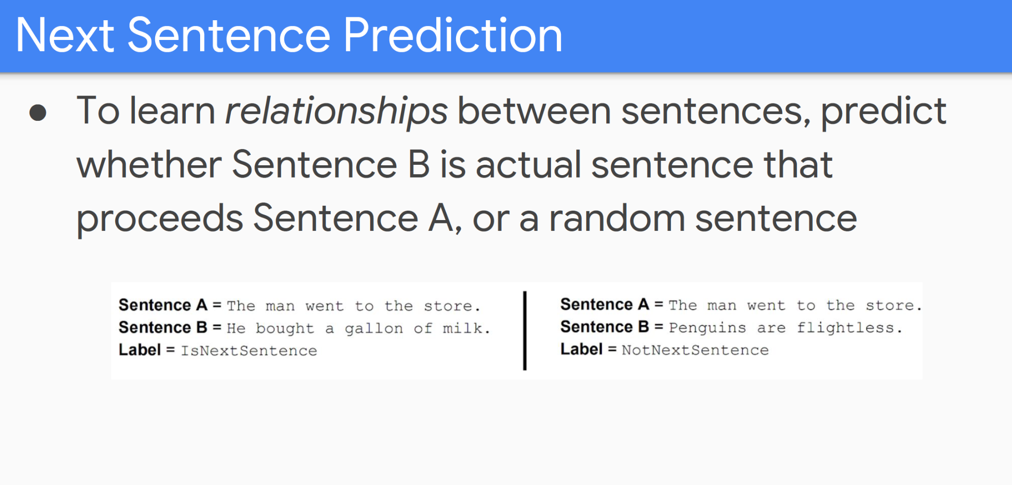
Next Sentence Prediction

Slide 34
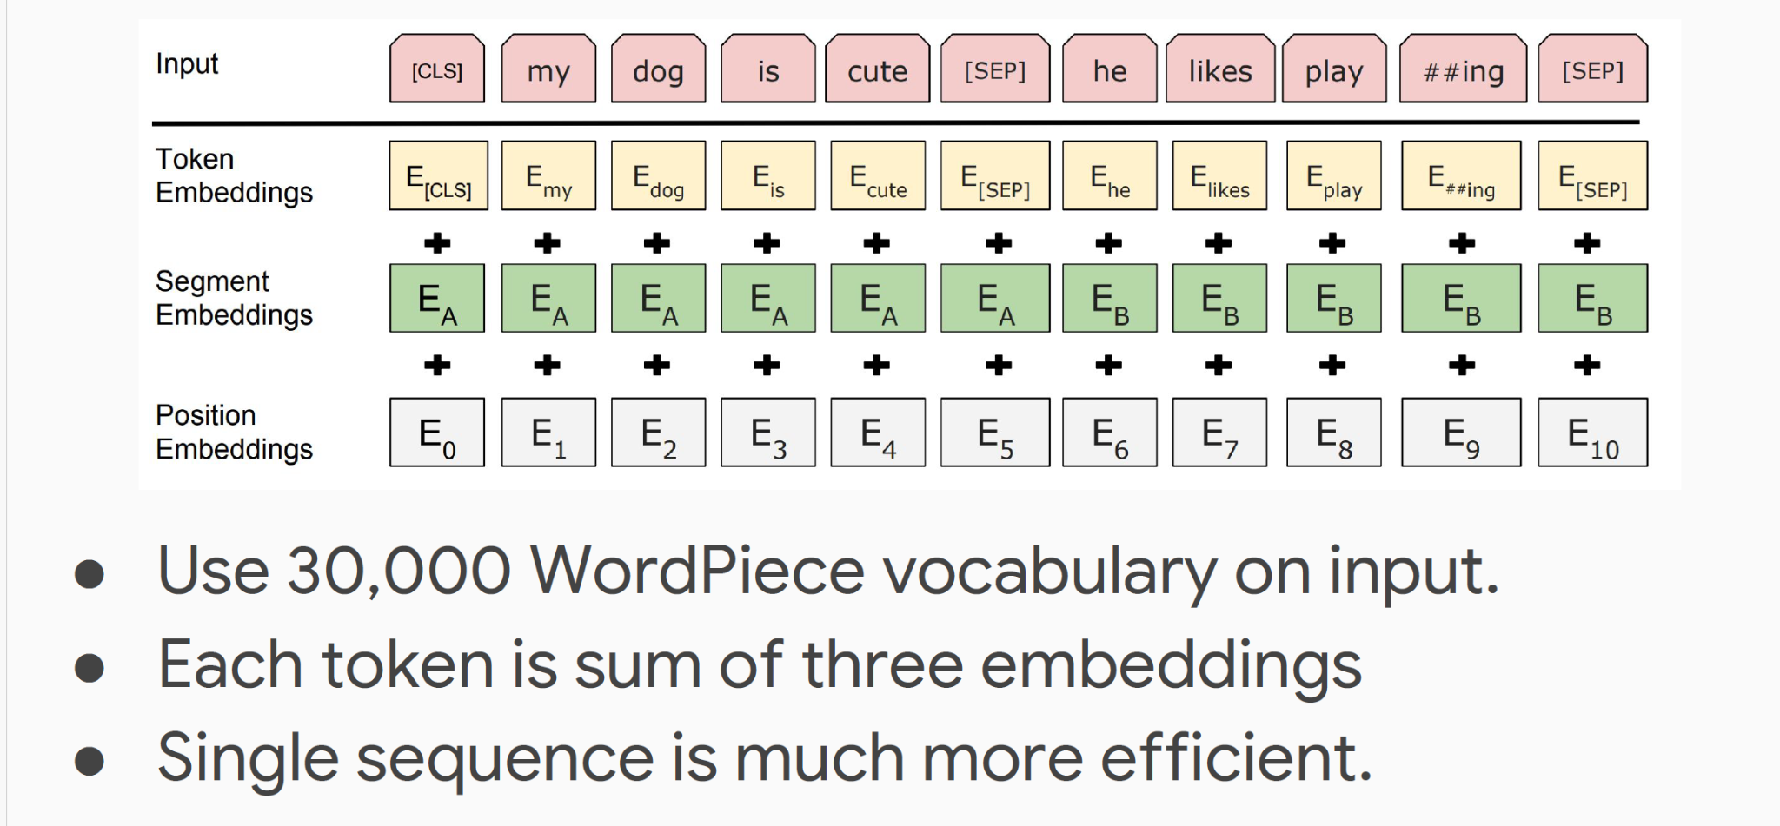
Input Representation

Slide 35
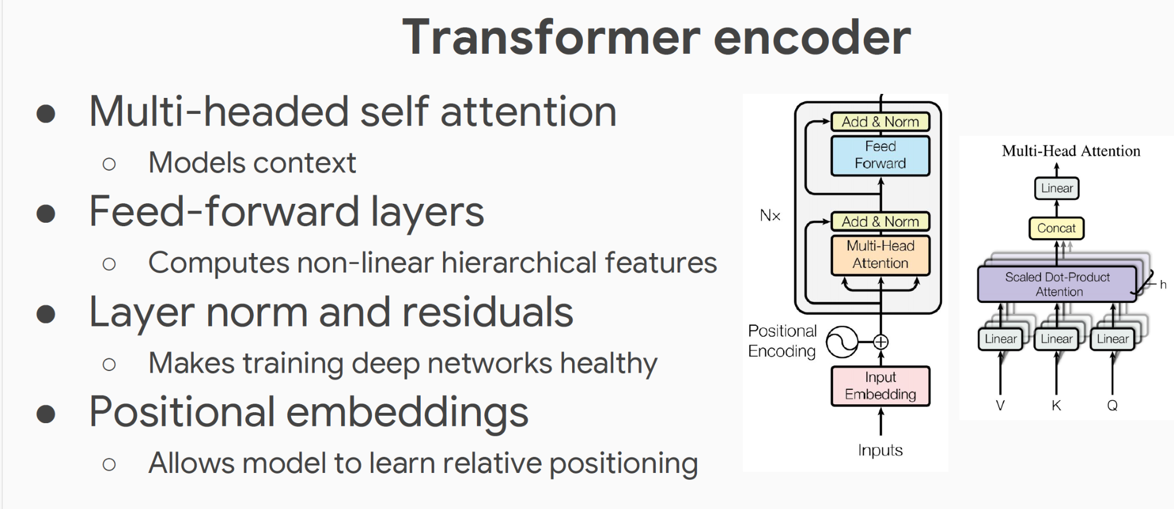
Model Architecture

Slide 36
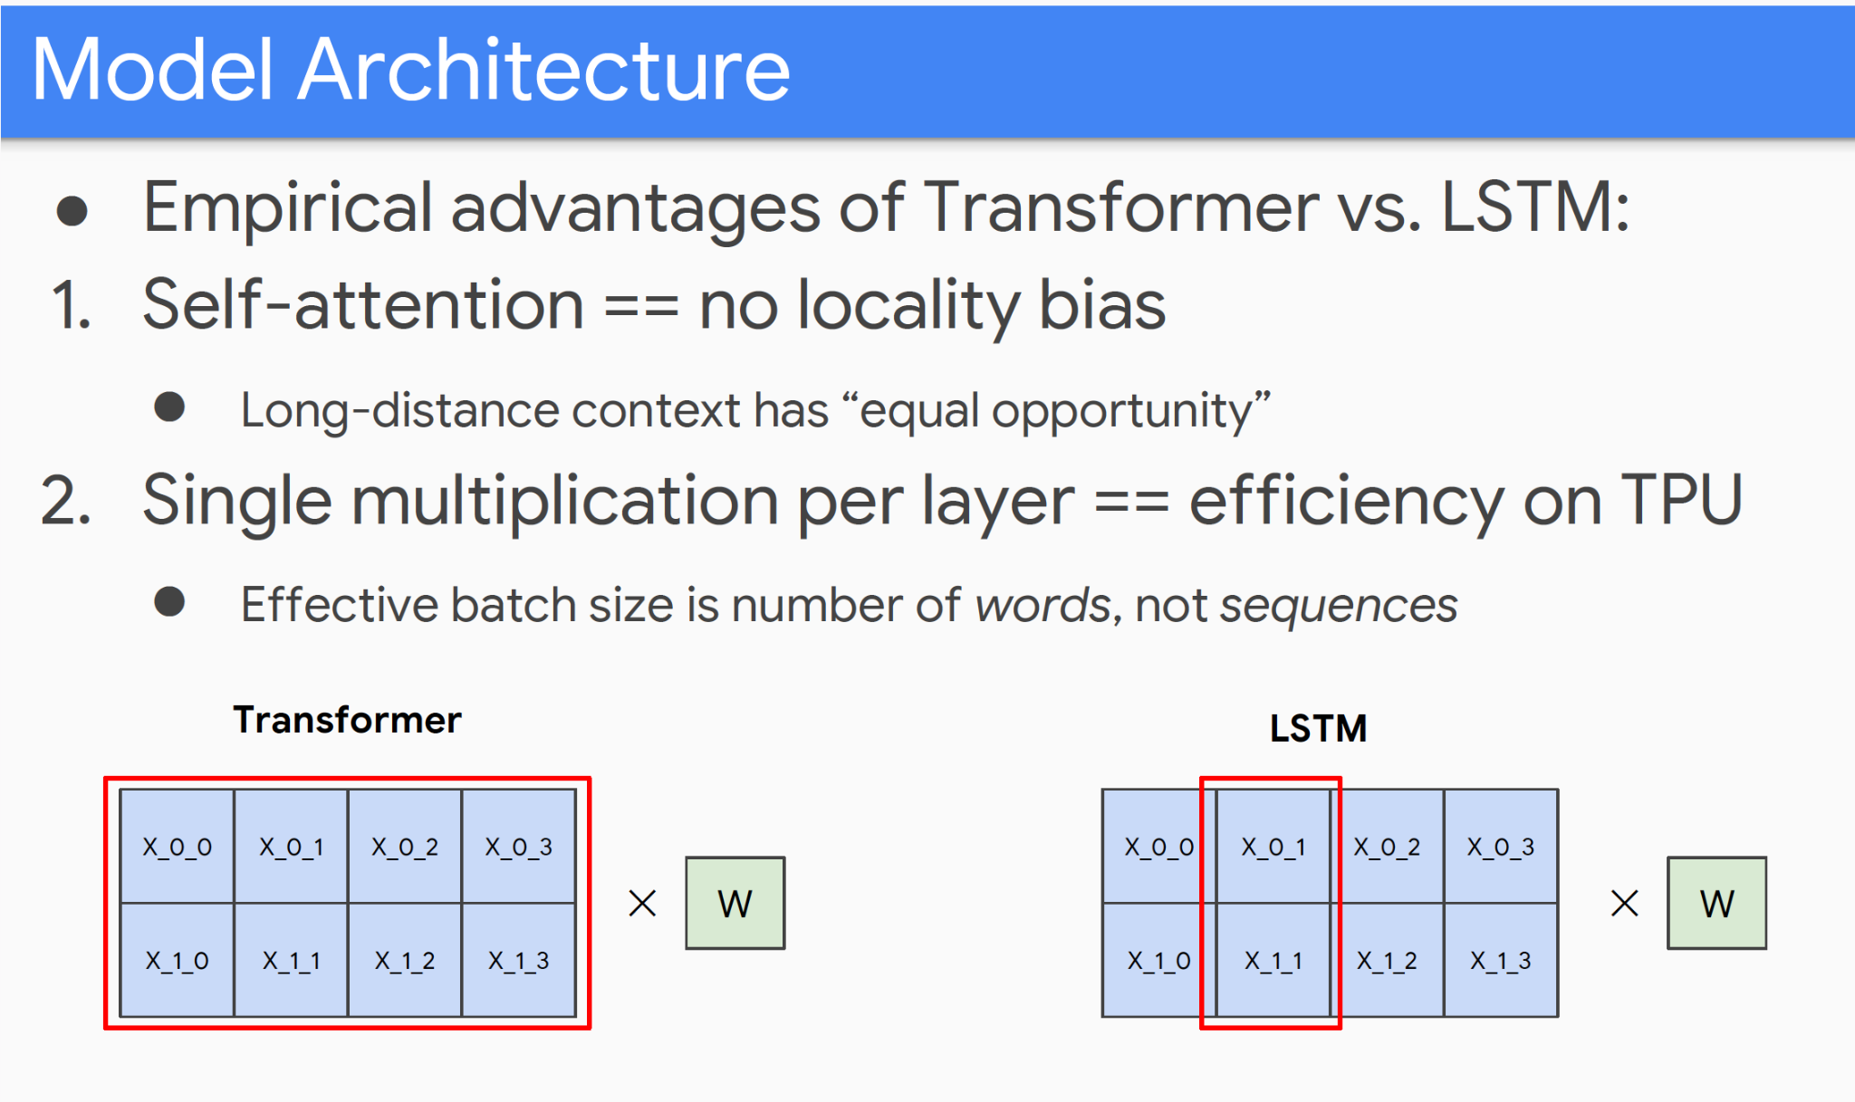
Model Architecture

Slide 37
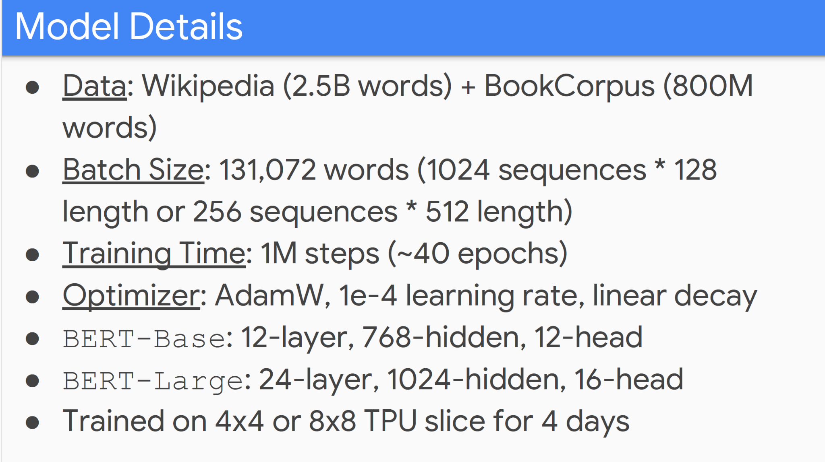
Model Details

Slide 38
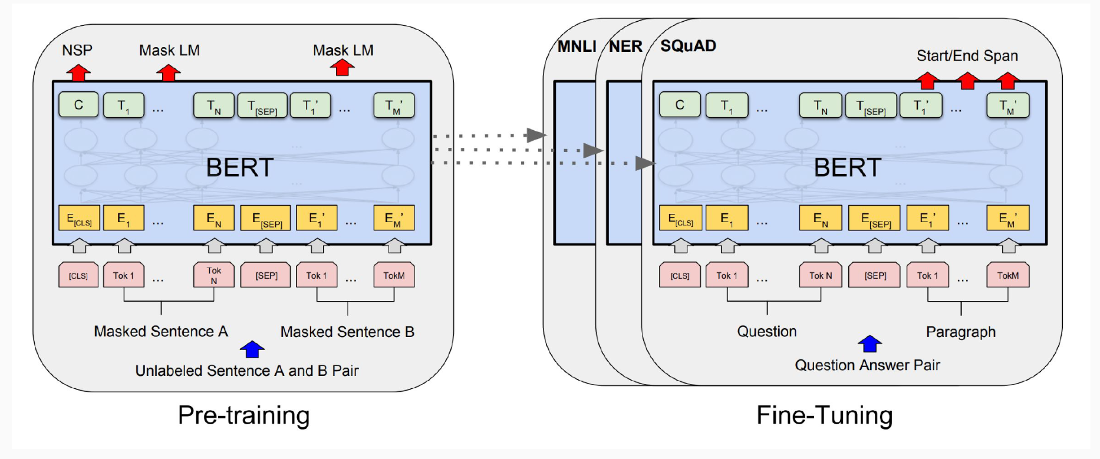
Fine-Tuning Procedure

Slide 39
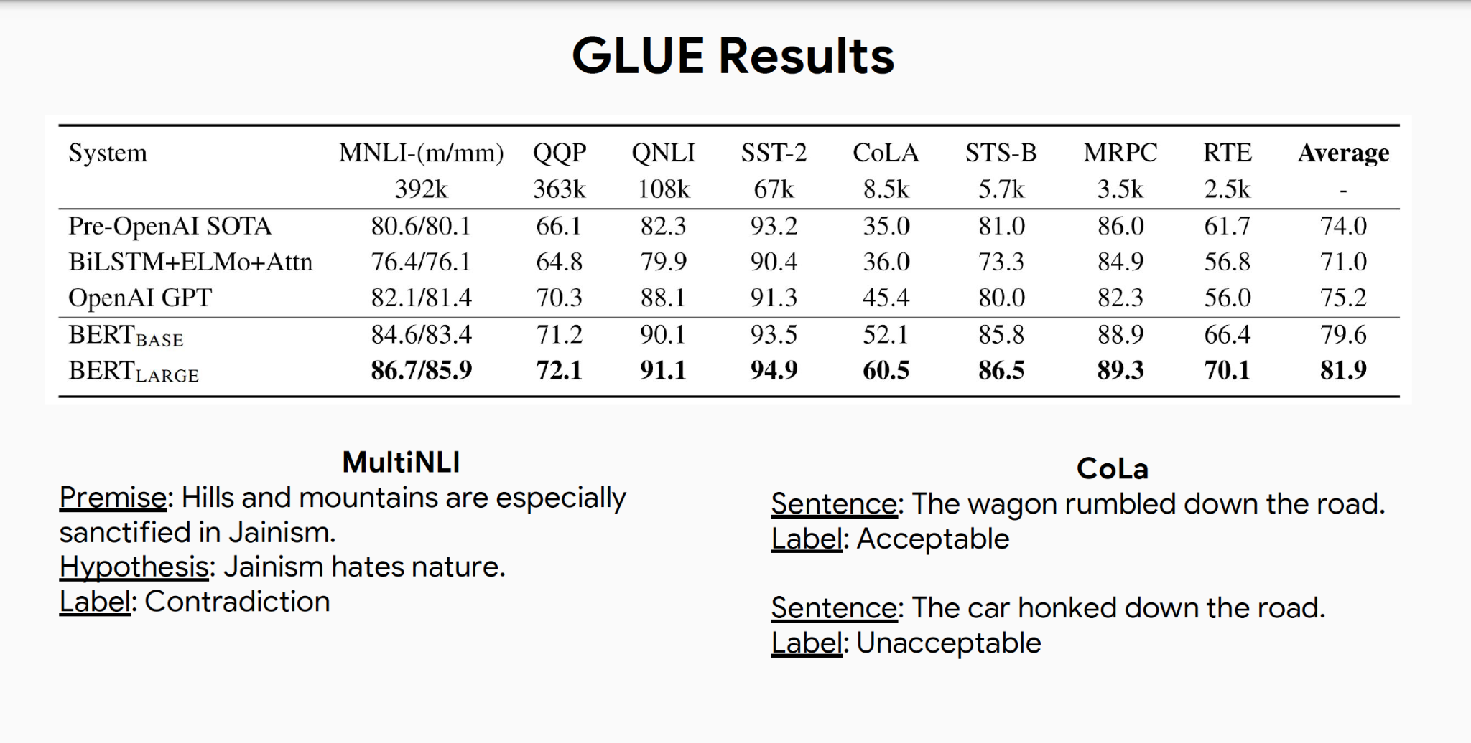
GLUE Results

Slide 40
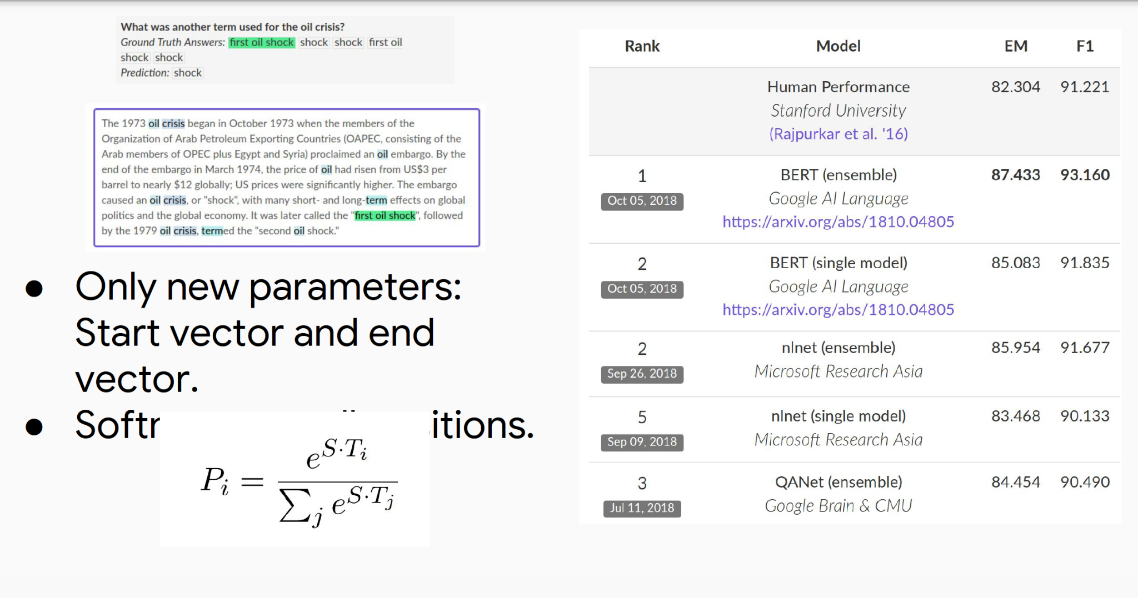
BERT

Slide 41
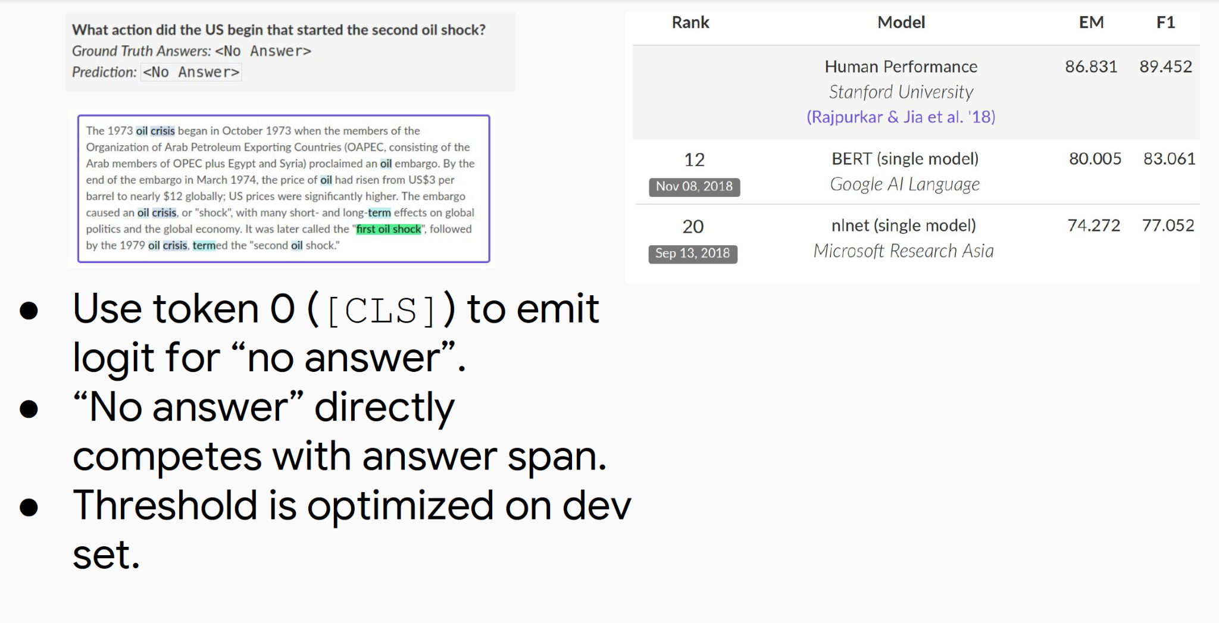
BERT

Slide 42
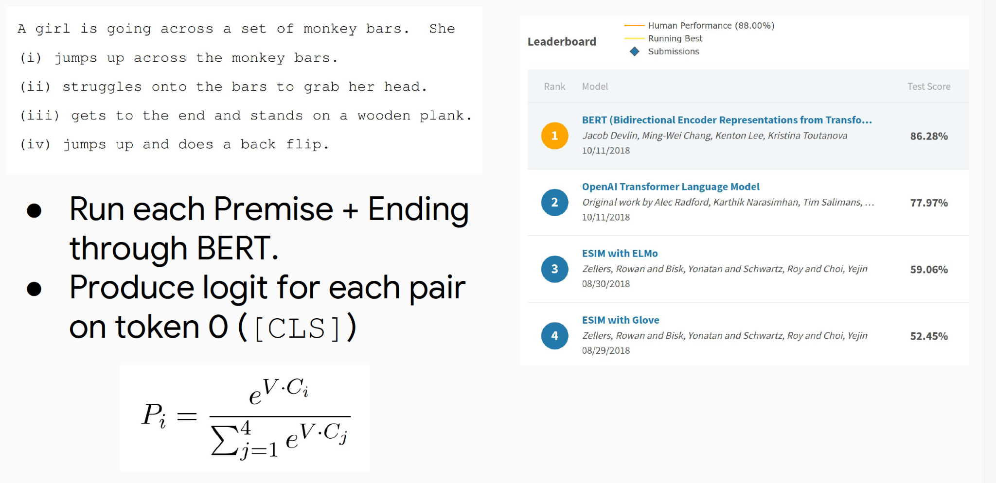
BERT

Slide 43
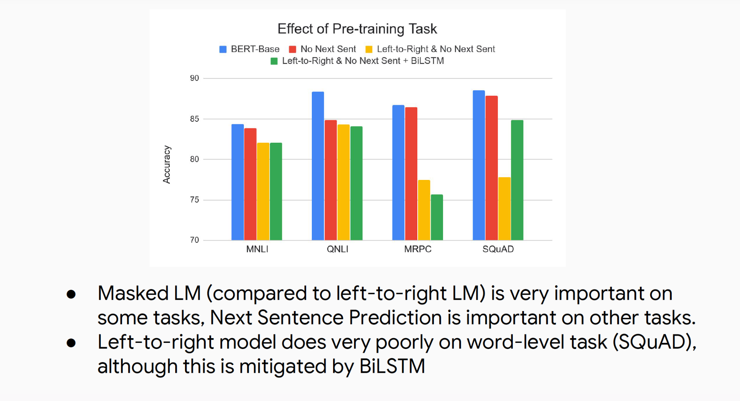
BERT

Slide 44
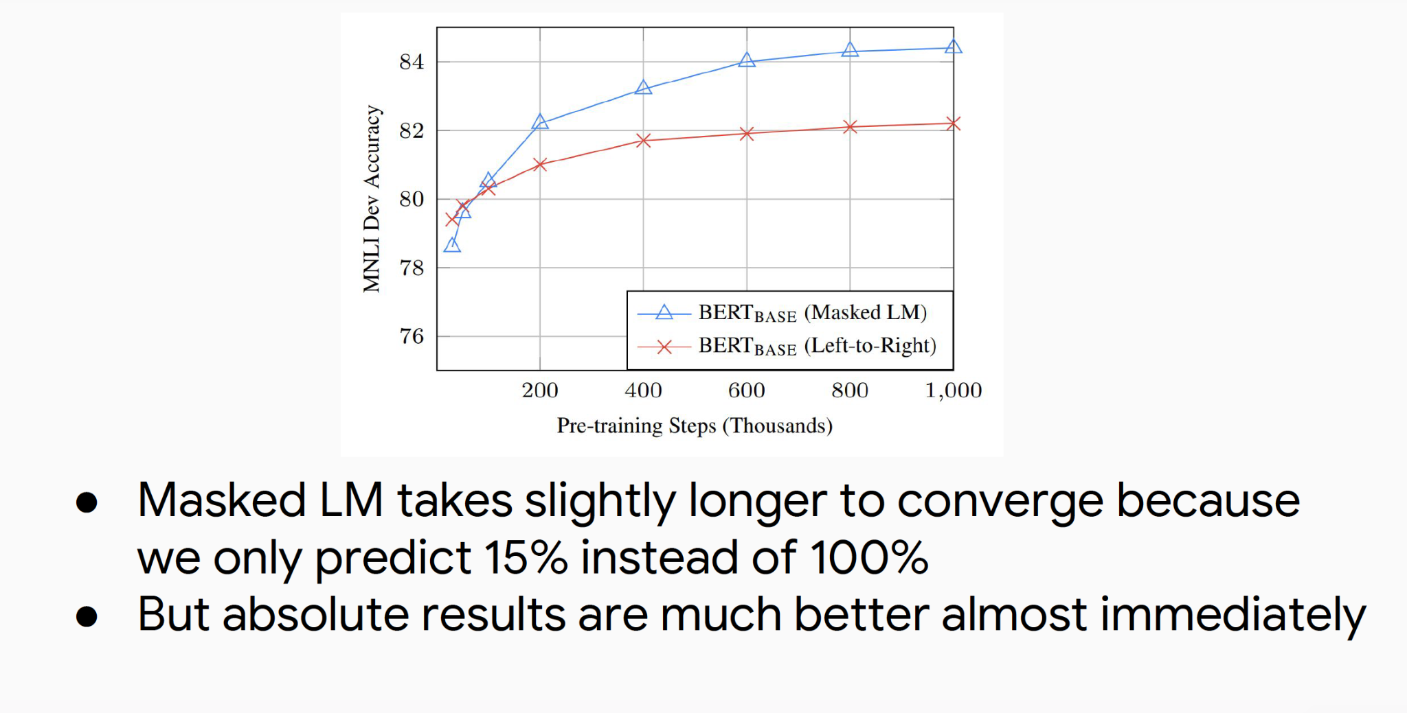
BERT

Slide 45
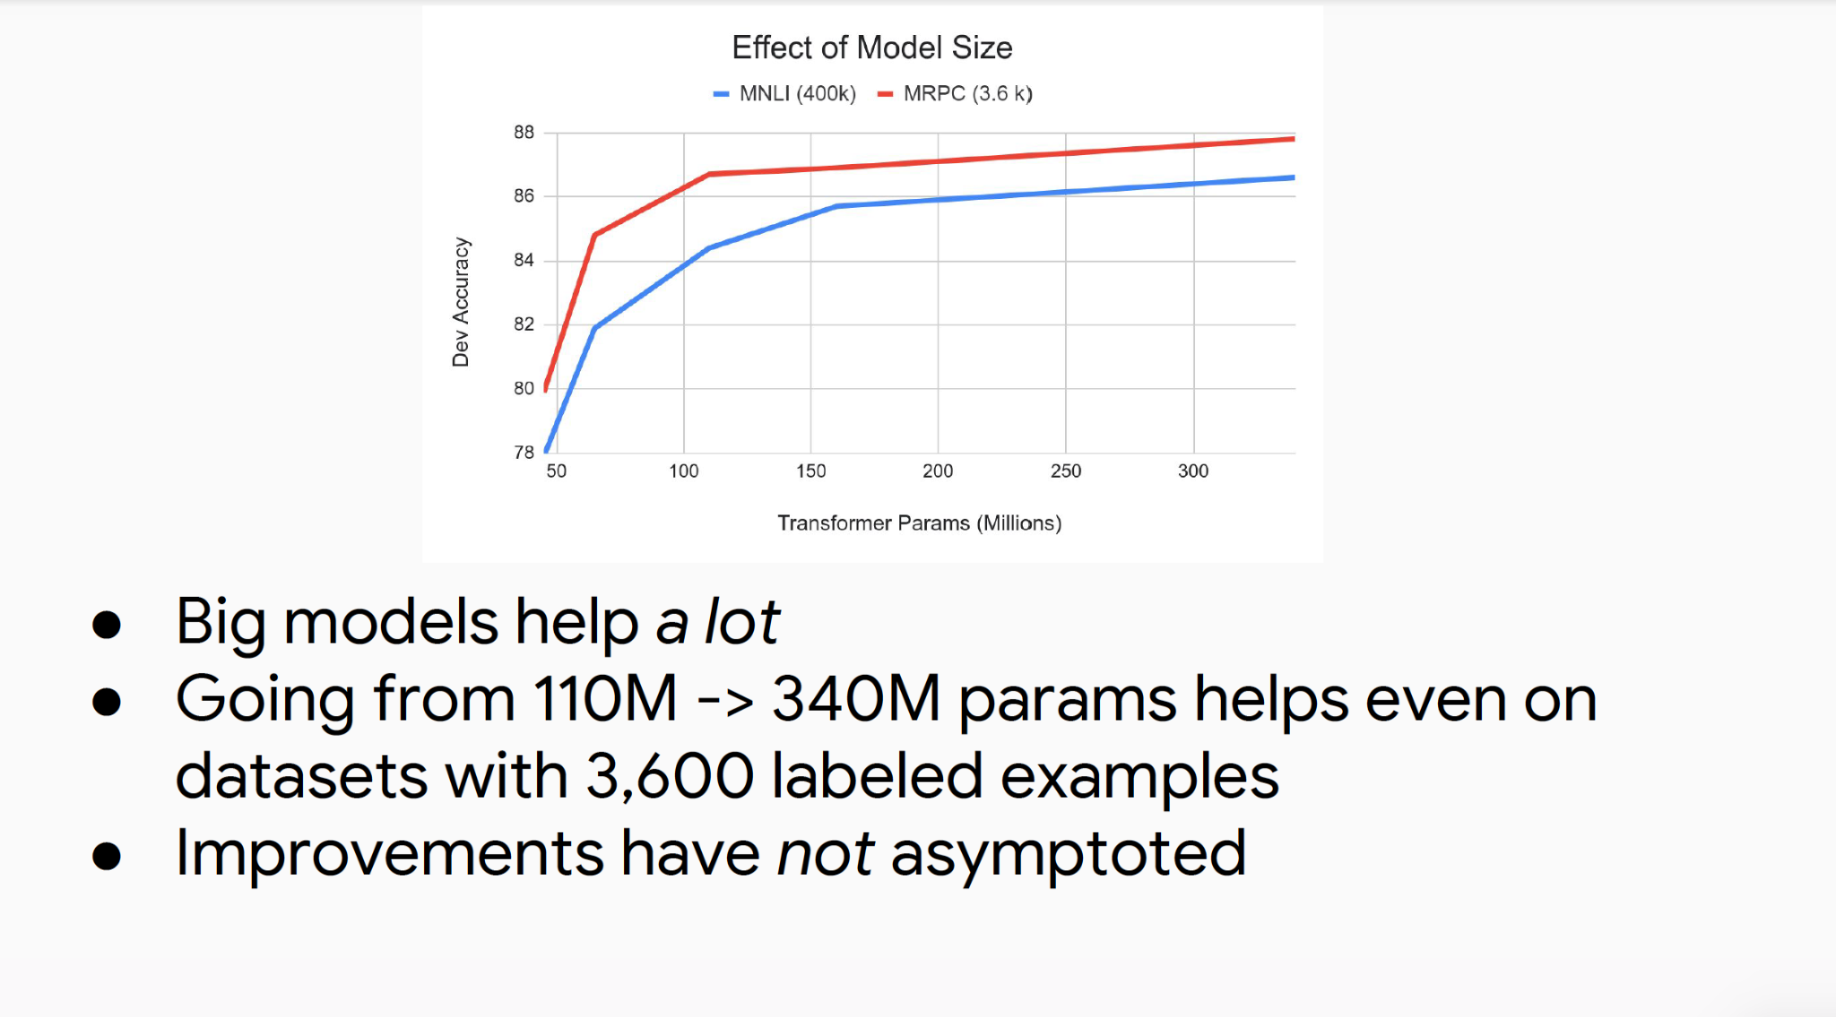
BERT

Slide 46
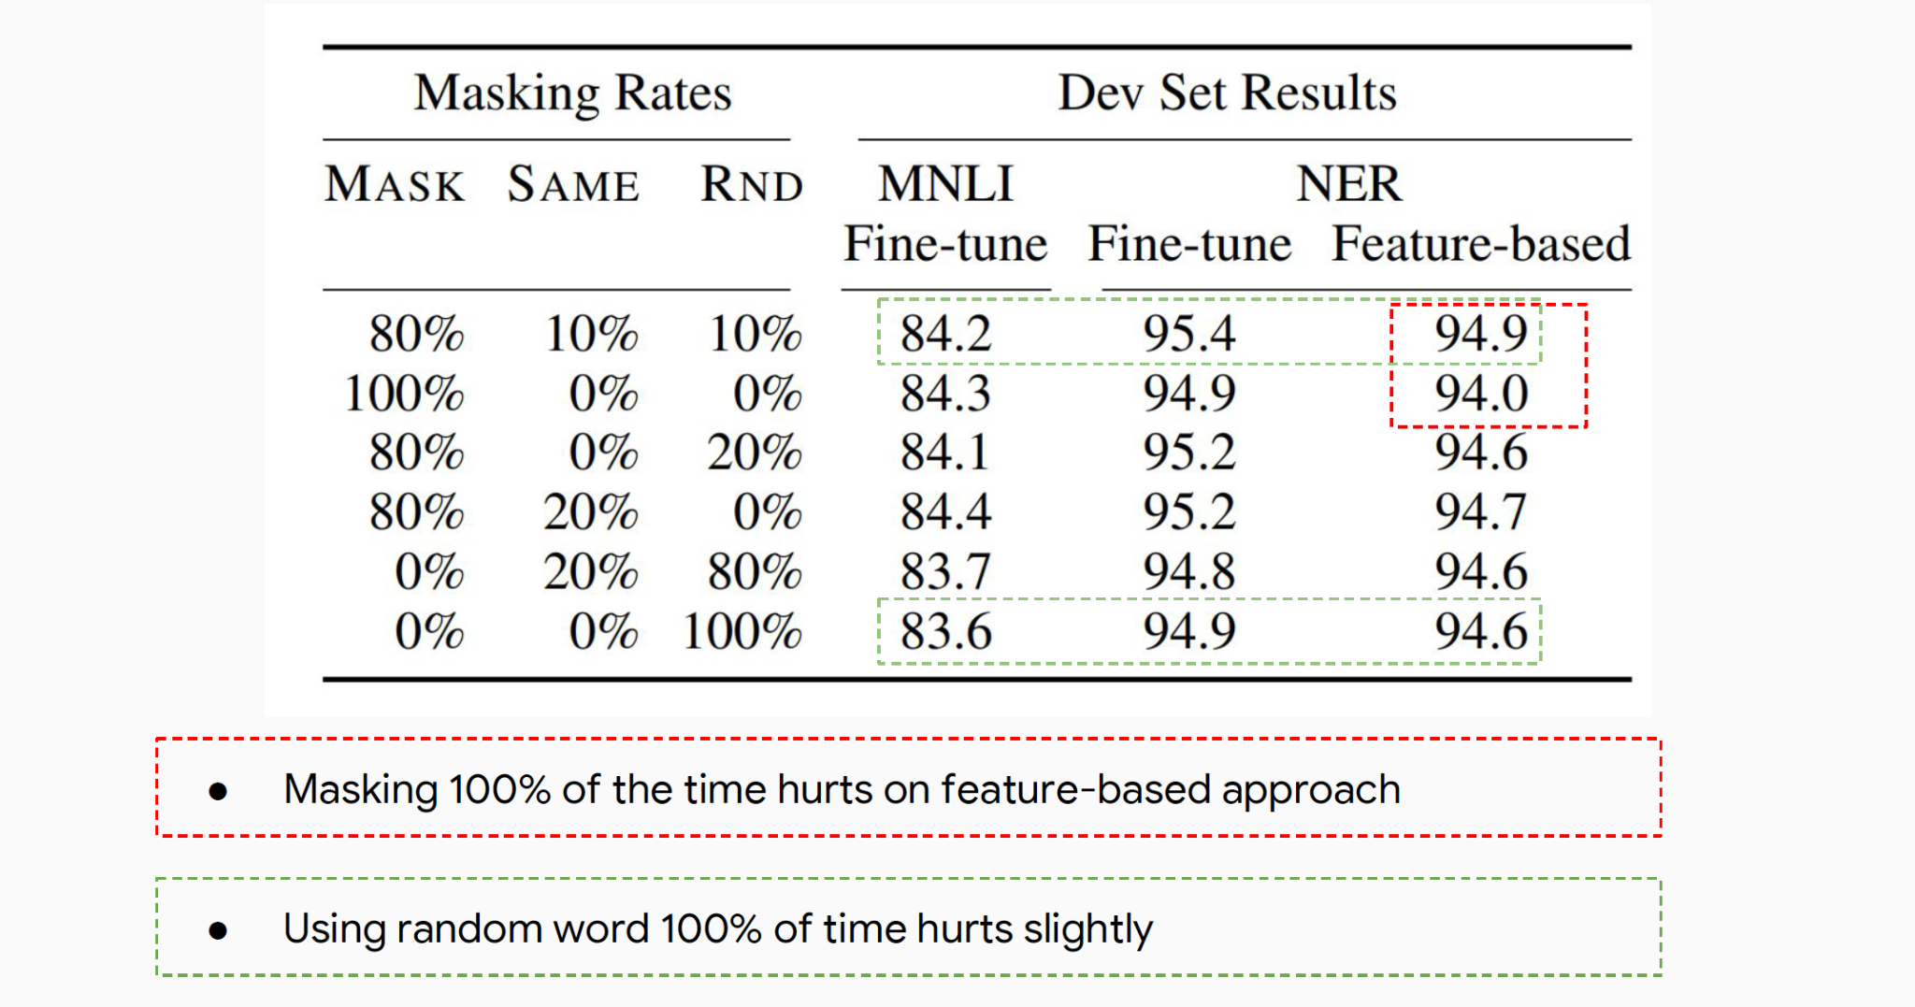
BERT

Slide 47
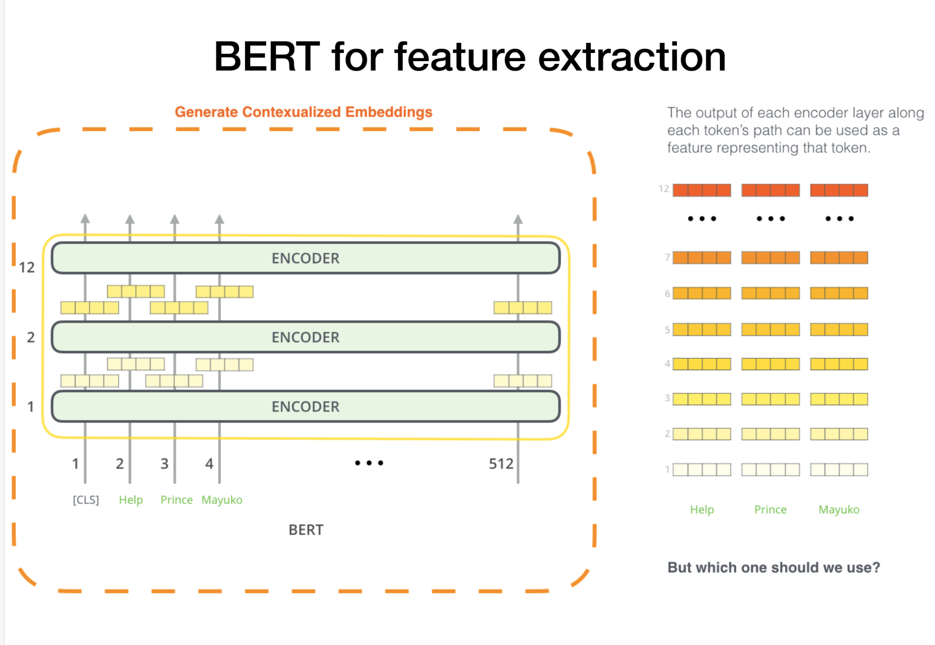
BERT

Slide 48
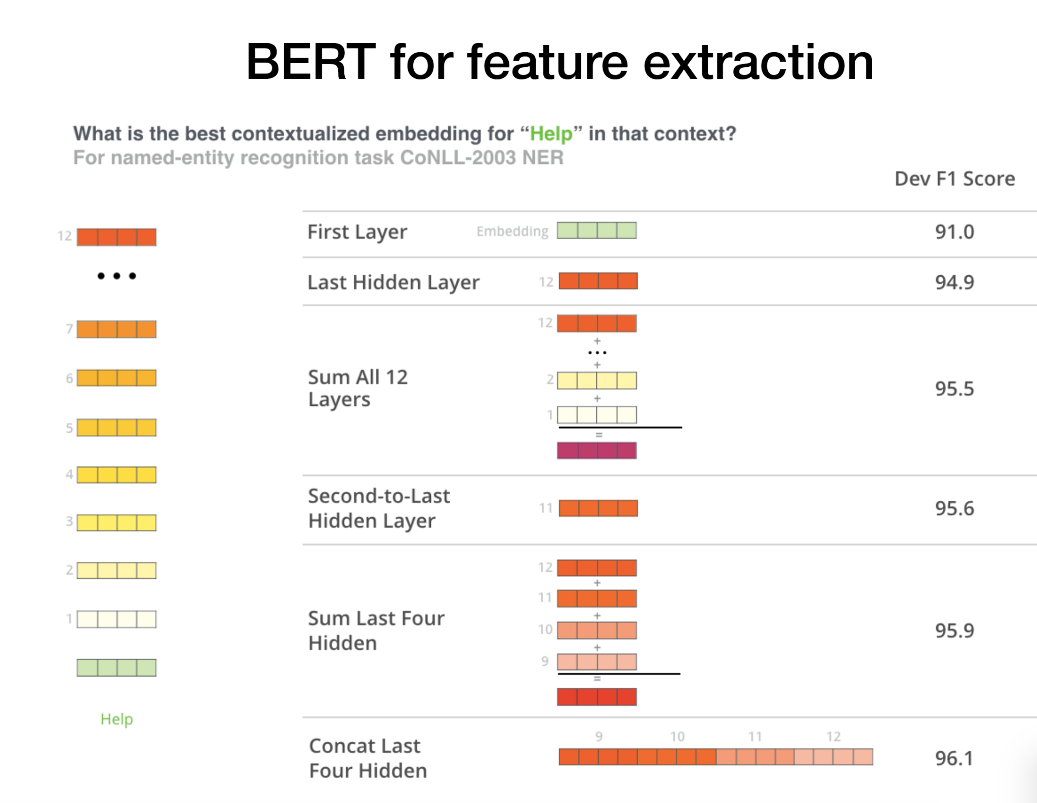
BERT for feature extraction

Slide 49
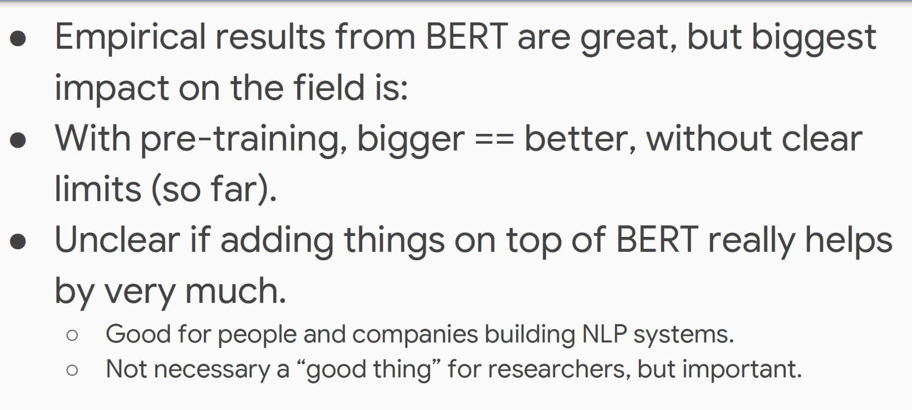
Conclusions

Slide 50
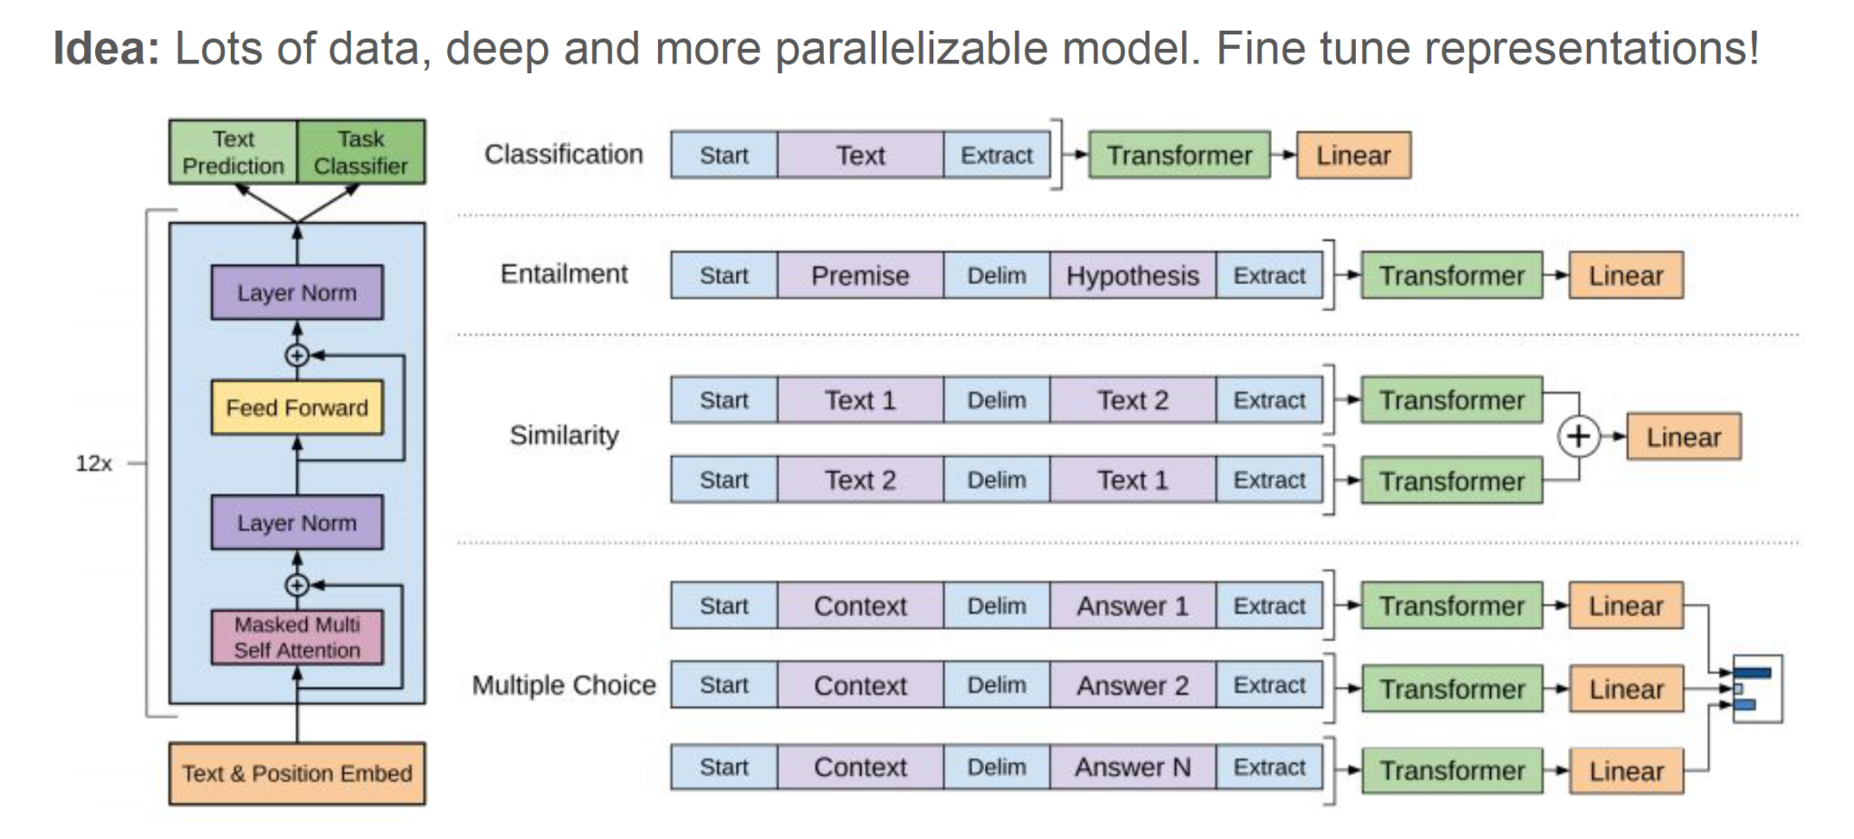
GPT-1

Slide 51
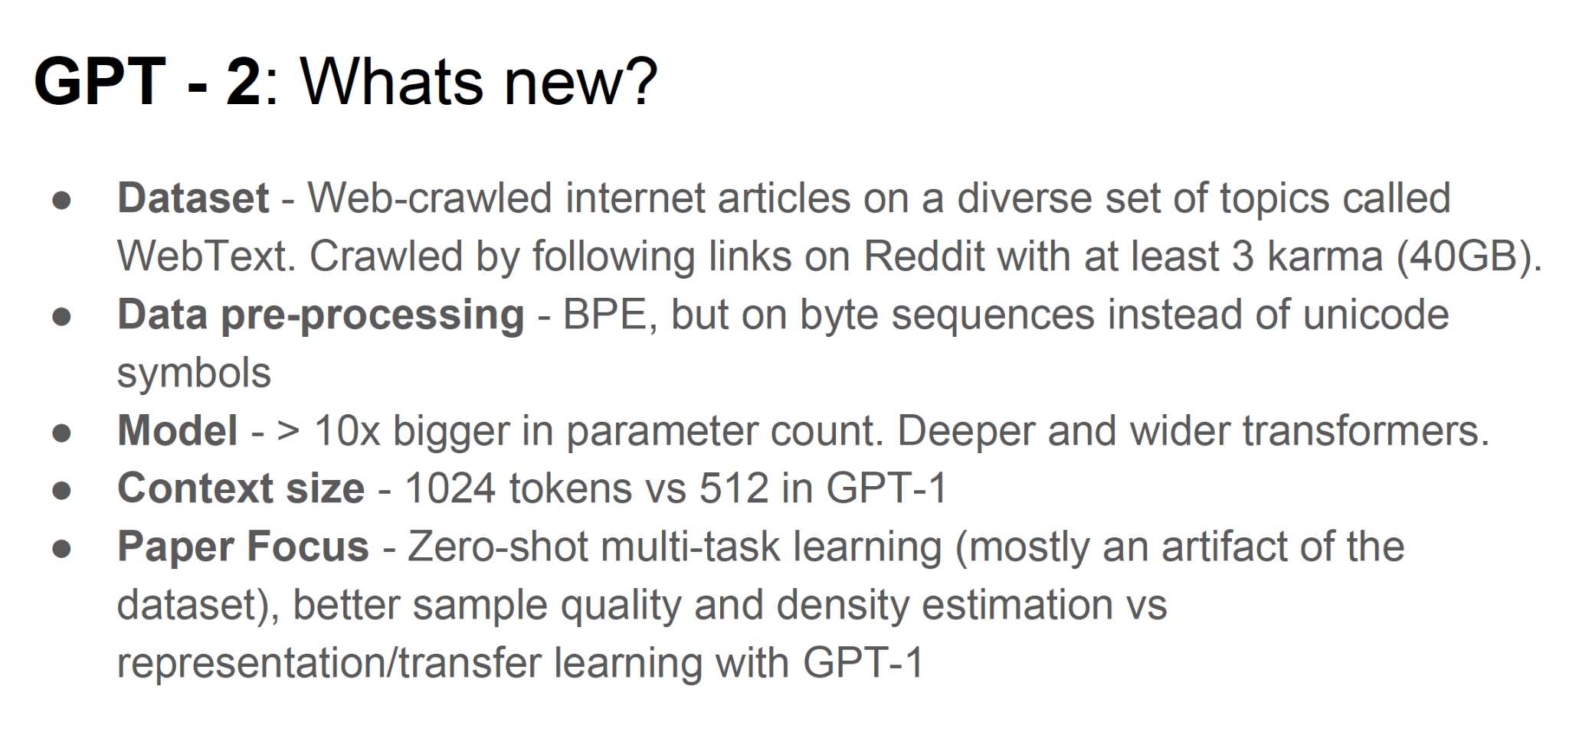
GPT-2 What's new?

Slide 52

Model Sizes

Slide 53

Better Language Models

Slide 54

Zero-shot multi-task learning

Slide 55

Zero-shot multi-task learning

Slide 56

Results

Slide 57

Sanity checks of dataset overlap

Slide 58

Comparing recent papers

Slide 59


Slide 60

Transformer -XL

Slide 61

Image-Transformer

Slide 62

Image-Transformer

Slide 63

Image-Transformer

Slide 64

Image-Transformer

Slide 65

Image-Transformer

Slide 66

Image-Transformer

Slide 67

Music Transformer

Slide 68

Music Transformer

Slide 69

Music Transformer

Slide 70

Conclusion

Slide 71

Active Research Area

Slide 72

Active Research Area

Slide 73

Multihead Attention

Slide 74

Masked Multihead Attention

Slide 75

Other Layers

Slide 76

Comparison

Slide 77
Questions?
Dr.Shruti Kshirsagar
Kshirsagarshruti1@gmail.com

Slide 78
References
1.https://ift6135h18.files.wordpress.com/2018/02/05_rnn.pdf
2.https://web.stanford.edu/class/cs224n/readings/cs224n-self-attention-transformers-2023_draft.pdf
3.http://cs231n.stanford.edu/2021/slides/2021/lecture_11.pdf
4.https://www.dropbox.com/s/e244jw50gv12498/Attention%20Models%20in%20Deep%20Learning.pdf?dl=0
5.https://www.dropbox.com/s/7sov3snzt2jcefc/SelfAttentionAndTransformers.pdf?dl=0

